Slide 1

Hypertension Canada 2025 Primary Care Guideline

Slide 2
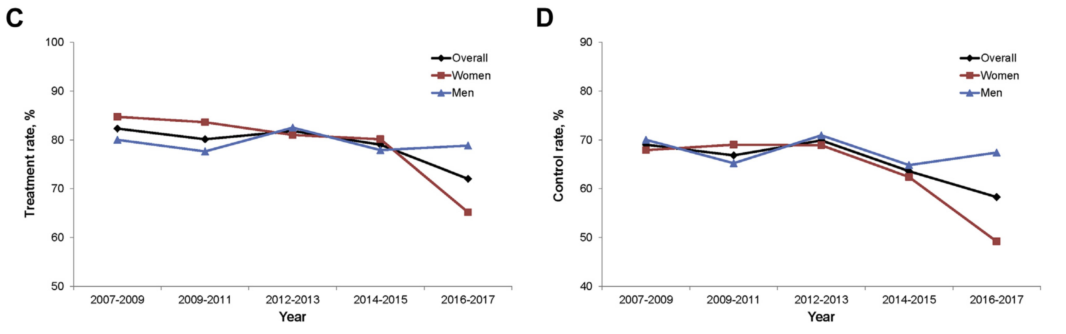


Declining treatment and control rates in Canada
2018-2019
2018-2019

Slide 3
Possible causes of declining control rates
Discordance in optimal therapeutic targets
Complexity of recommendations
Inadequate implementation strategies
Suboptimal engagement of primary care professionals (family MDs, NPs, nurses, pharmacists)
Loss of industry support for training activities
Leung AA, CMAJ 2021

Slide 4
Hypertension Canada 2024-2028
2024-2025
With Step 1
2025
2026-2028
Goupil, CJC 2024

Slide 5
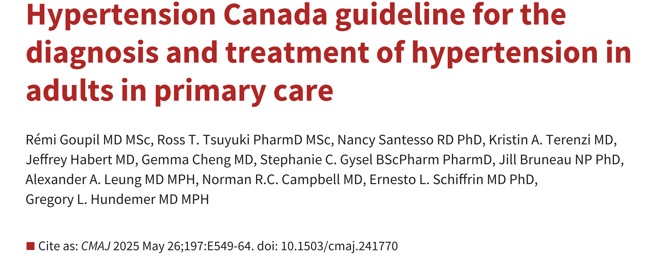





Published in French on June 16th 2025

Slide 6
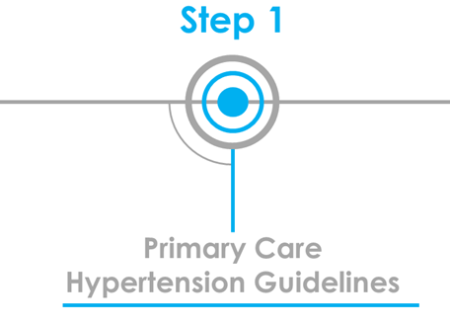
Why primary care guidelines?
Management of > 90% of patients with hypertension
Complexity of guidelines can lead to suboptimal uptake of recommendations and therapeutic inertia
Numerous requests to simplify diagnostic and management algorithms
Clear need to provide evidenced-based, pragmatic, streamlined, and easy-to-implement recommendations tailored for primary care

Slide 7


Methodology
Created for and by primary care professionals (family medicine, nursing, pharmacy) and patient-partners
Based on the HEARTS framework (developed by the WHO)
  See webinar for more details
  Underlying principle = Adoption of pragmatic streamlined algorithms
ADAPTE Evidence Review Process
  Review of WHO, AHA, ESC data
Optimization of recommendations and algorithms following a peer review process (Fall 2024)

Slide 8
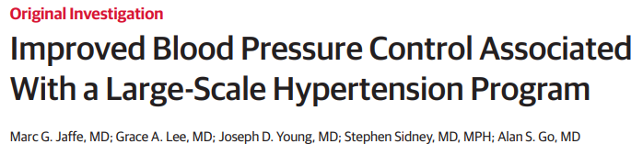
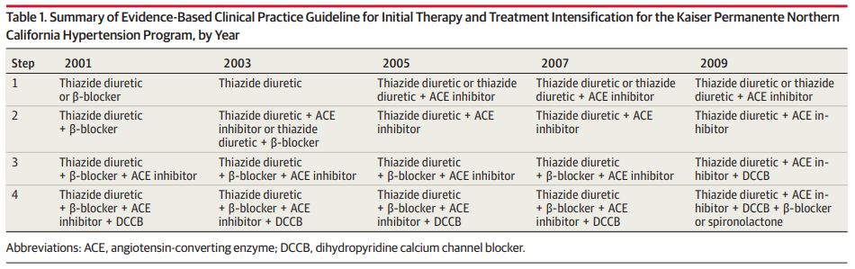
HEARTS Background

Slide 9
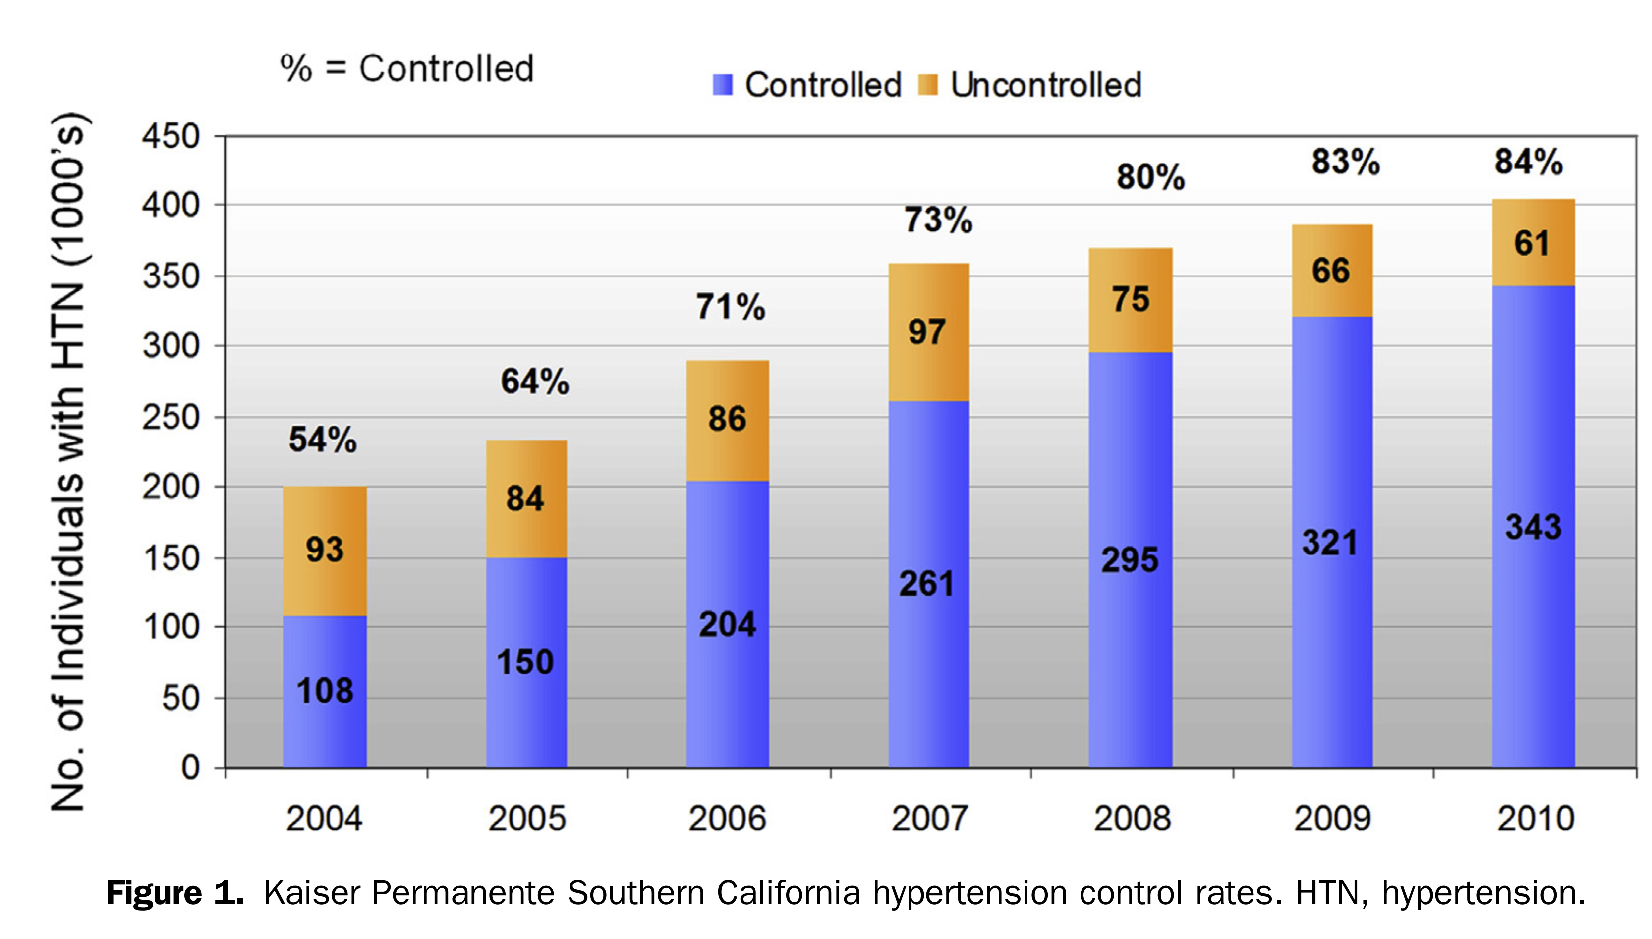
HEARTS – Does it work?
Global acceptability
Implementation in 40+ countries
17M+ individuals integrated into the program
Not a rigid protocol
Designed to be adapted to meet each country’s unique needs

Slide 10
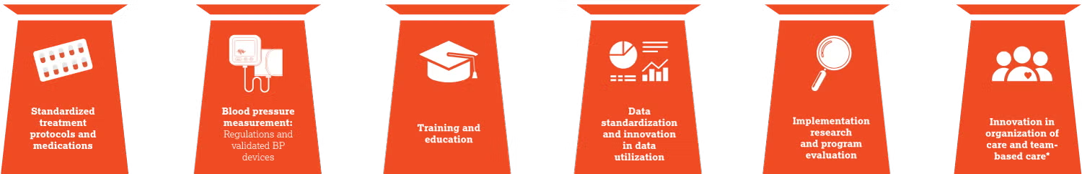
6 Pillars of HEARTS

Slide 11
Scope
Target users: primary care providers
  Family physicians
  Physician assistants
  Nurse practitioners
  Nurses
  Pharmacists
Intended as a framework for managing most (but not all) cases of hypertension in primary care. Notable exceptions:
  Not intended for people who are pregnant or trying to become pregnant
  Not intended for children
  Clinical discretion must still be applied on a case-by-case basis

Slide 12
Guideline Committee Composition
Family medicine physicians
Pharmacists
Nurse practitioner
Hypertension specialists
Methodologist with expertise in guideline development
Patient partners with lived experience with hypertension

Slide 13
Selection of priority topics
2023 Canadian Hypertension Congress
  Consensus request for developing streamlined, pragmatic, and evidence-based hypertension guidelines specifically focused on primary care
Emphasis on topics of hypertension diagnosis and management
  Limit the number of recommendations to those deemed most relevant to primary care

Slide 14
Methodology
9 recommendations
  Adaptation process (ADAPTE)
  Strength of recommendation and certainty of evidence (GRADE)
  Scientific rationale and evidence tables
  Values and preferences
Diagnosis and treatment algorithms based on the above recommendations
  Applying HEARTS framework

Slide 15
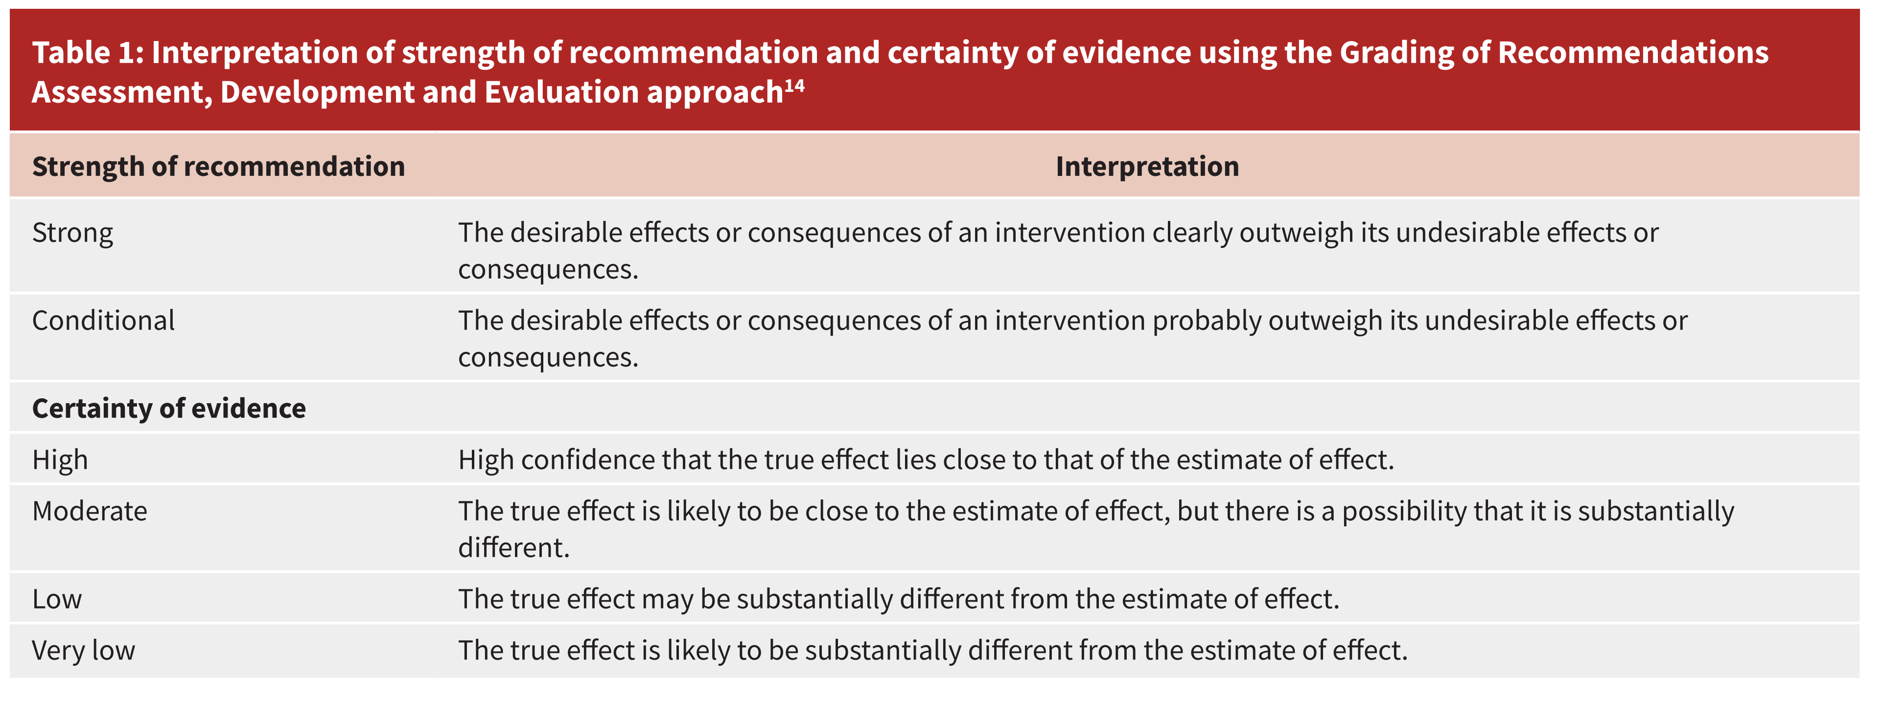
GRADE System

Slide 16
DIAGNOSTIC
Recommendation | Strength of recommandation | Certainty of the evidence
BP assessment with a validated automated device and using a standardized method is recommended. | Strong | Moderate
Out-of-office BP assessment is recommended to confirm the diagnosis of hypertension or to detect white-coat hypertension and masked hypertension. | Strong | Moderate
The definition of hypertension in adults is recommended as BP ≥ 130/80 mm Hg when measured with a validated device under optimal conditions. | Strong | Moderate

Slide 17
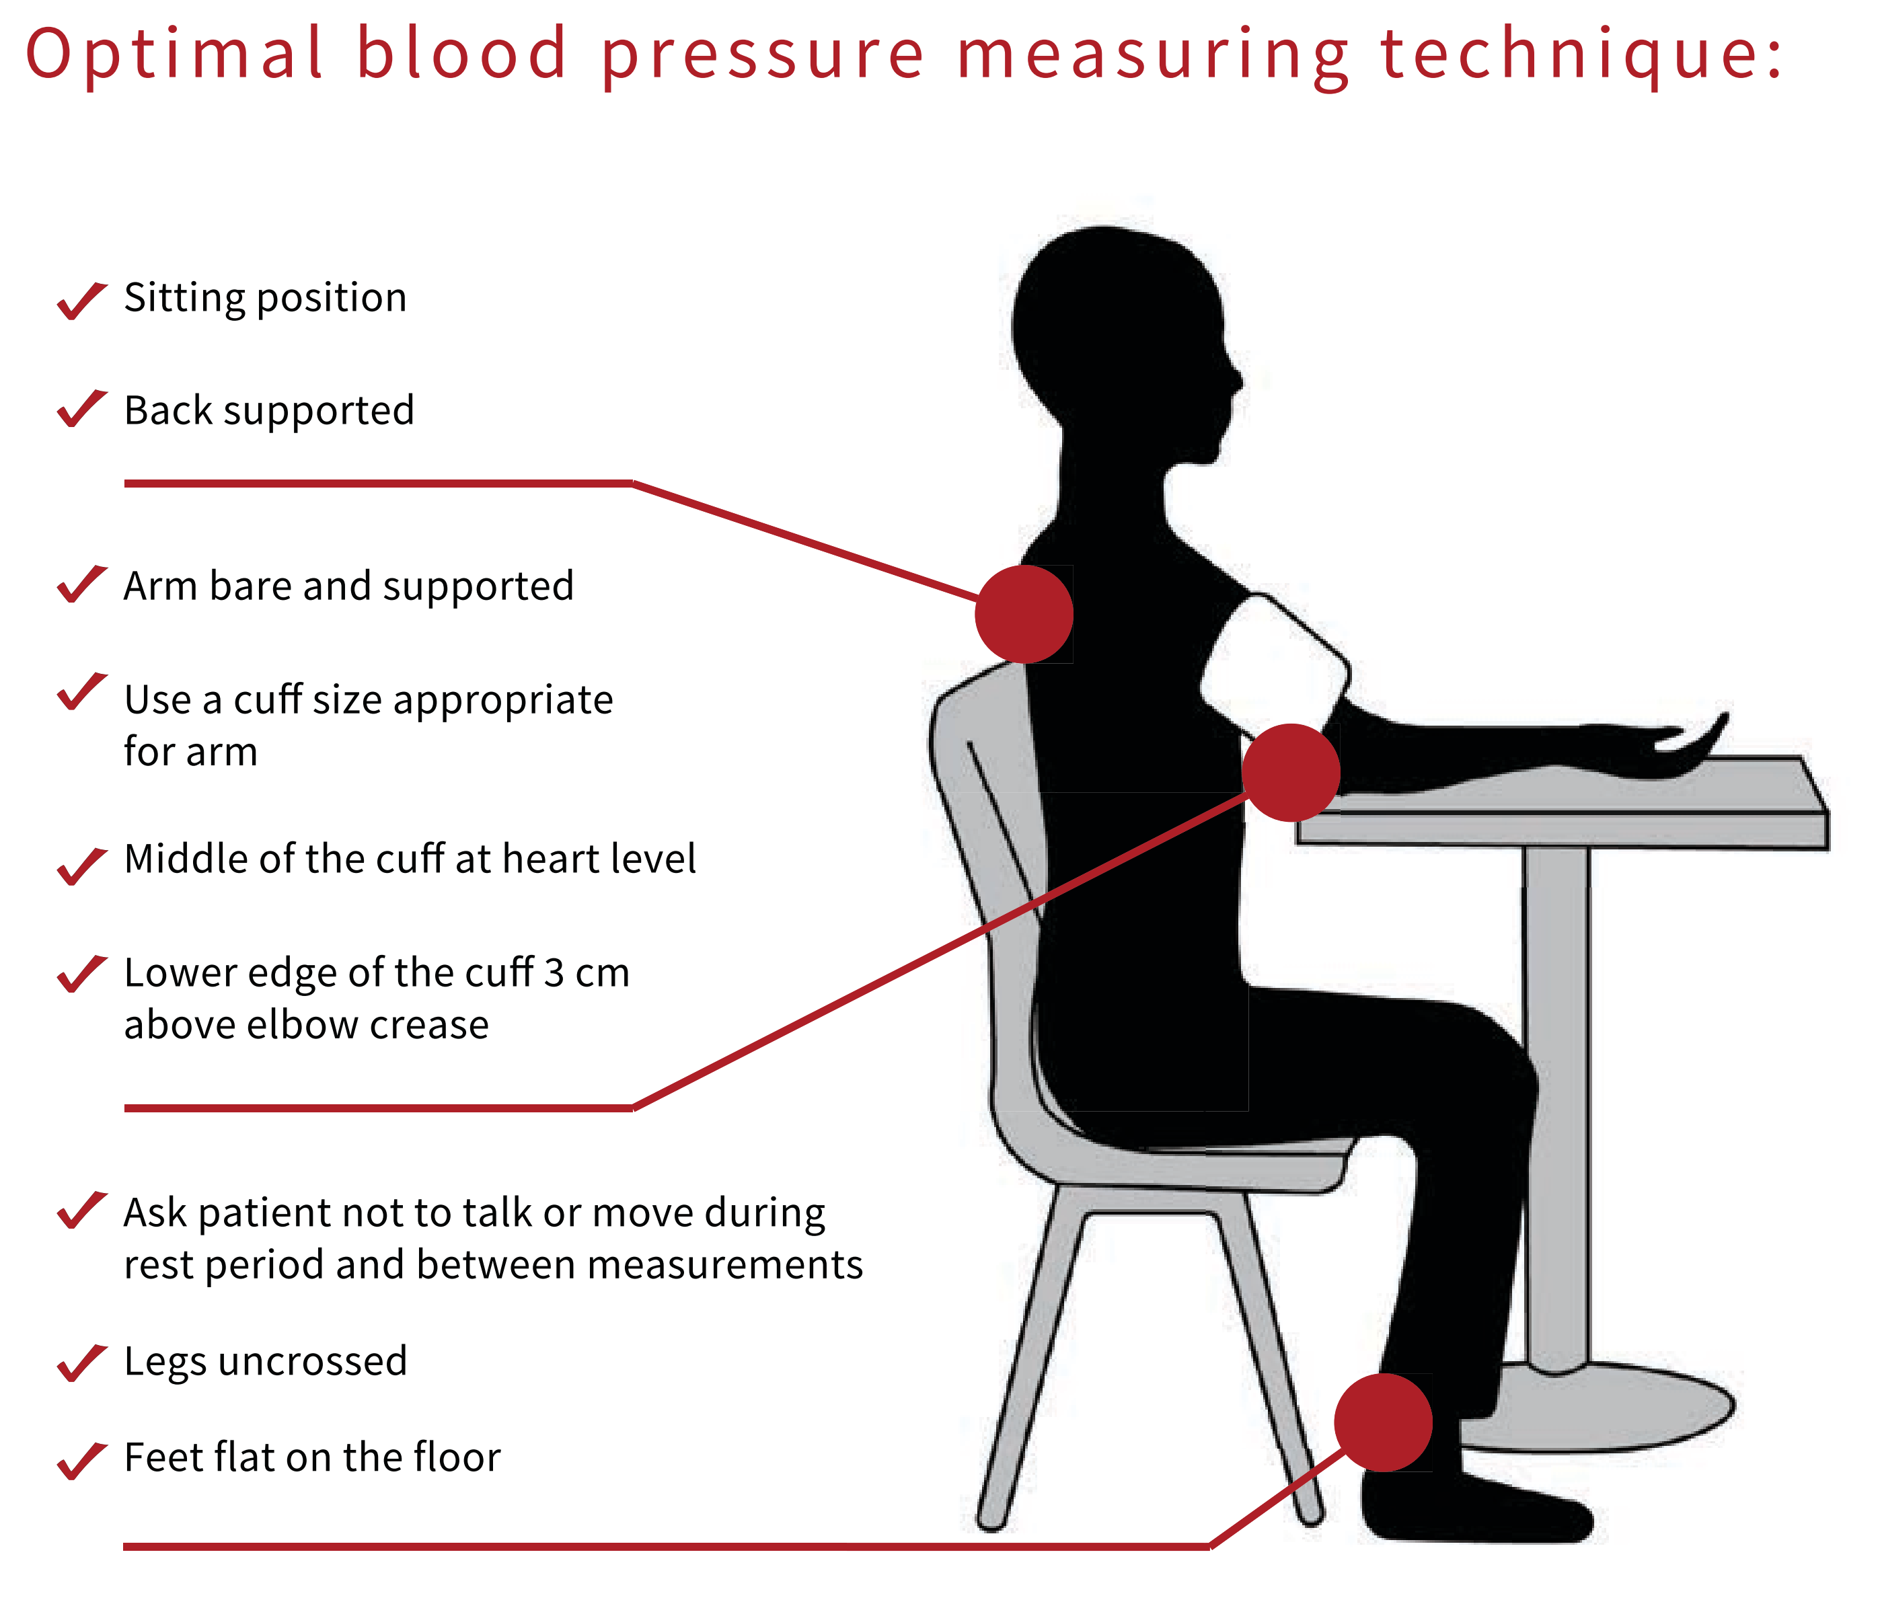
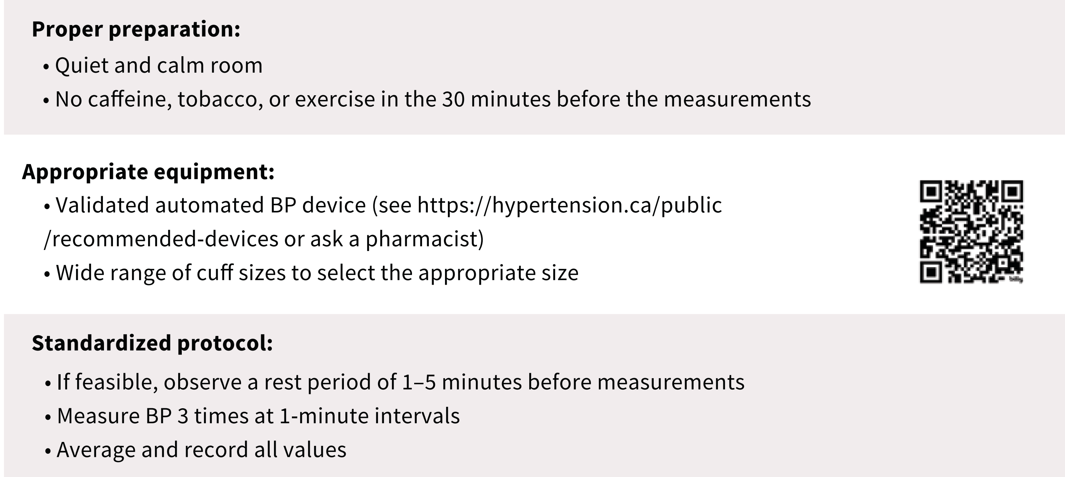

Slide 18
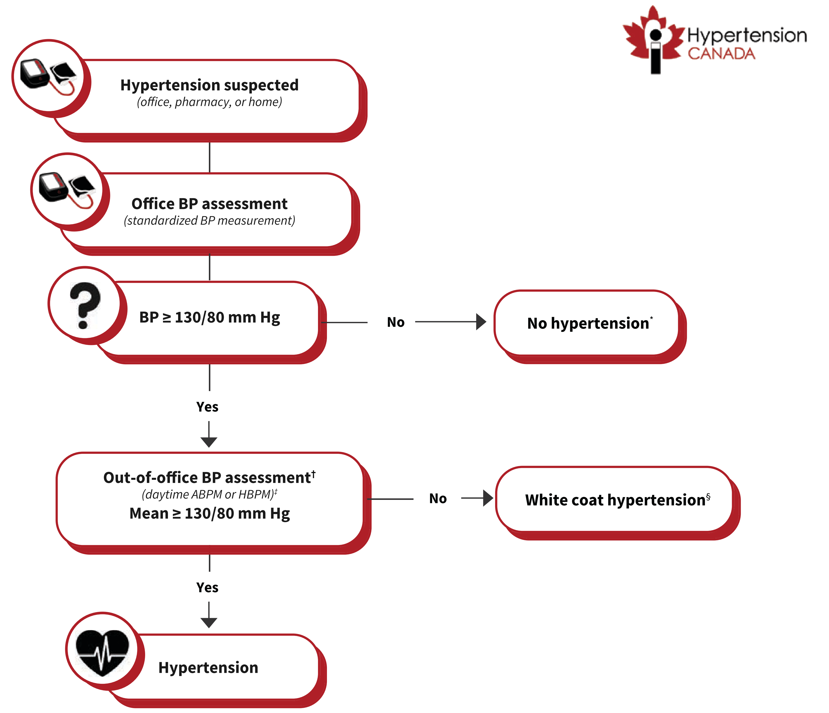
Notes:
Suggested algorithm for the diagnosis of hypertension in primary care. Note: ABPM = ambulatory blood pressure monitor, BP = blood pressure, HBPM = home blood pressure monitor. *Continue yearly or opportunistic BP monitoring. Perform out-of-office BP assessment if masked hypertension is suspected. †If unavailable or infeasible, repeat office BP assessment at a separate visit. ‡Use Hypertension Canada–recommended or other validated home BP devices. §Continue yearly or opportunistic BP monitoring.

Slide 19
Particularities
A standardized technique (AOBP) using a validated device should be used to implement the recommendations
  A non-standardized (or auscultatory) technique does not allow for sufficiently reliable and reproducible measurements, and can overestimate the BP by 5-10 mm Hg
New threshold for defining hypertension in Canada: 130/80 mm Hg (instead of 135/85 mm Hg)
  Approx. 9% more people with hypertension in Canada
  But < 1.5% more will require pharmacological treatment (unpublished data)
A single number to remember
  A BP of 130/80 mm Hg measured by standardized AOBP corresponds to the same cardiovascular risk as a BP of 130/80 mm Hg measured at home or with ABPM (daytime average)

Slide 20
TREATMENT (1)
Recommendation | Strength of recommandation | Certainty of the evidence
Healthy lifestyle changes are recommended for all adults with hypertension. | Strong | High
Pharmacotherapy initiation for hypertension is recommended for adults with BP ≥ 140/90 mm Hg and for adults with systolic BP 130–139 mm Hg at high cardiovascular disease risk. | Strong | High
Treatment, including healthy lifestyle changes with or without pharmacotherapy, is recommended for adults with hypertension to achieve a target systolic BP < 130 mm Hg, provided the treatment is well tolerated . | Strong | High

Slide 21
Healthy lifestyle habits
Decrease sodium intake (WHO: < 2 g per day)
Increase potassium intake (WHO: > 3.5 g per day)
Achieve a healthy weight
Exercise regularly (WHO: 150-300 min per week of moderate-intensity aerobic activity)
Limit alcohol intake
Stop all tobacco products

Slide 22
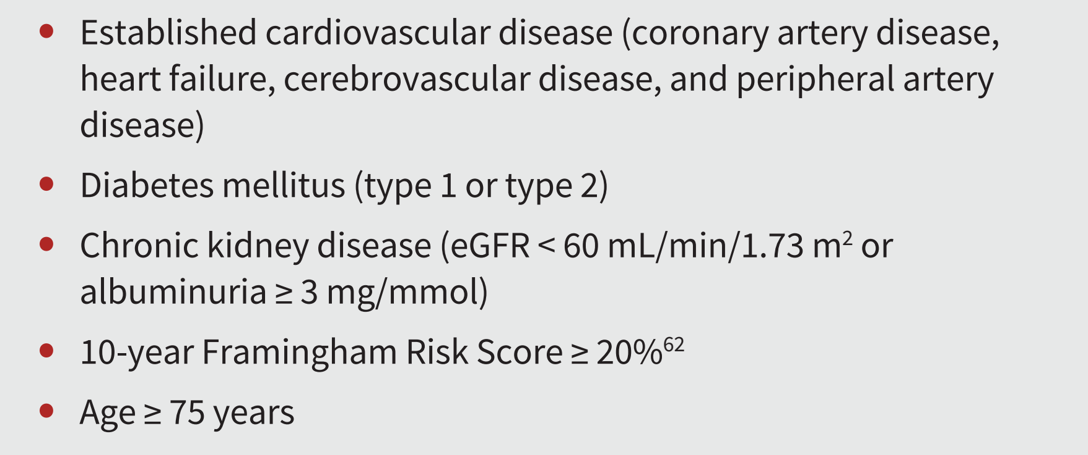
High cardiovascular disease risk conditions

Slide 23
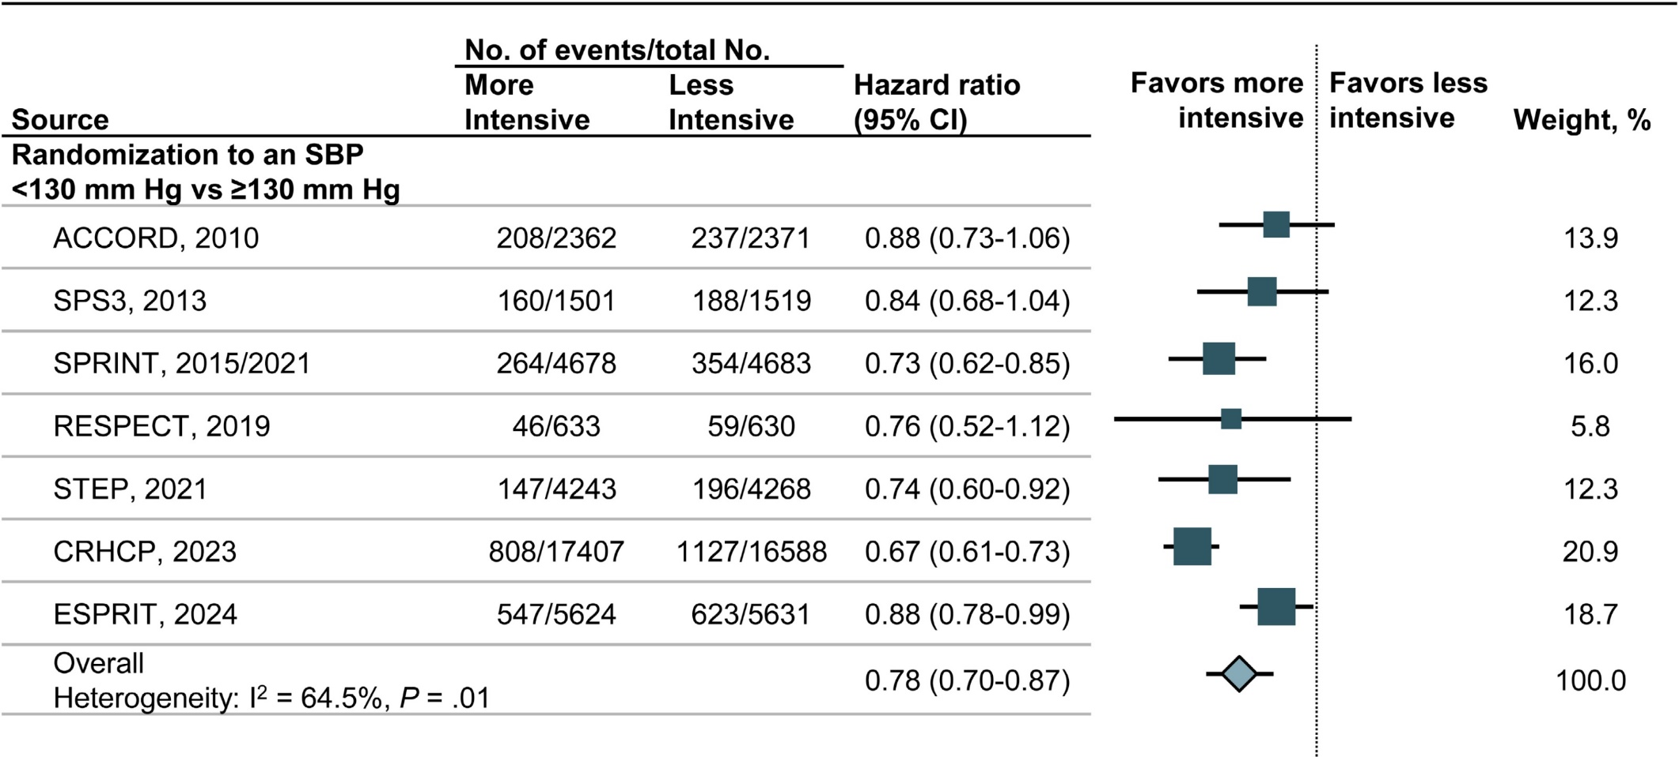
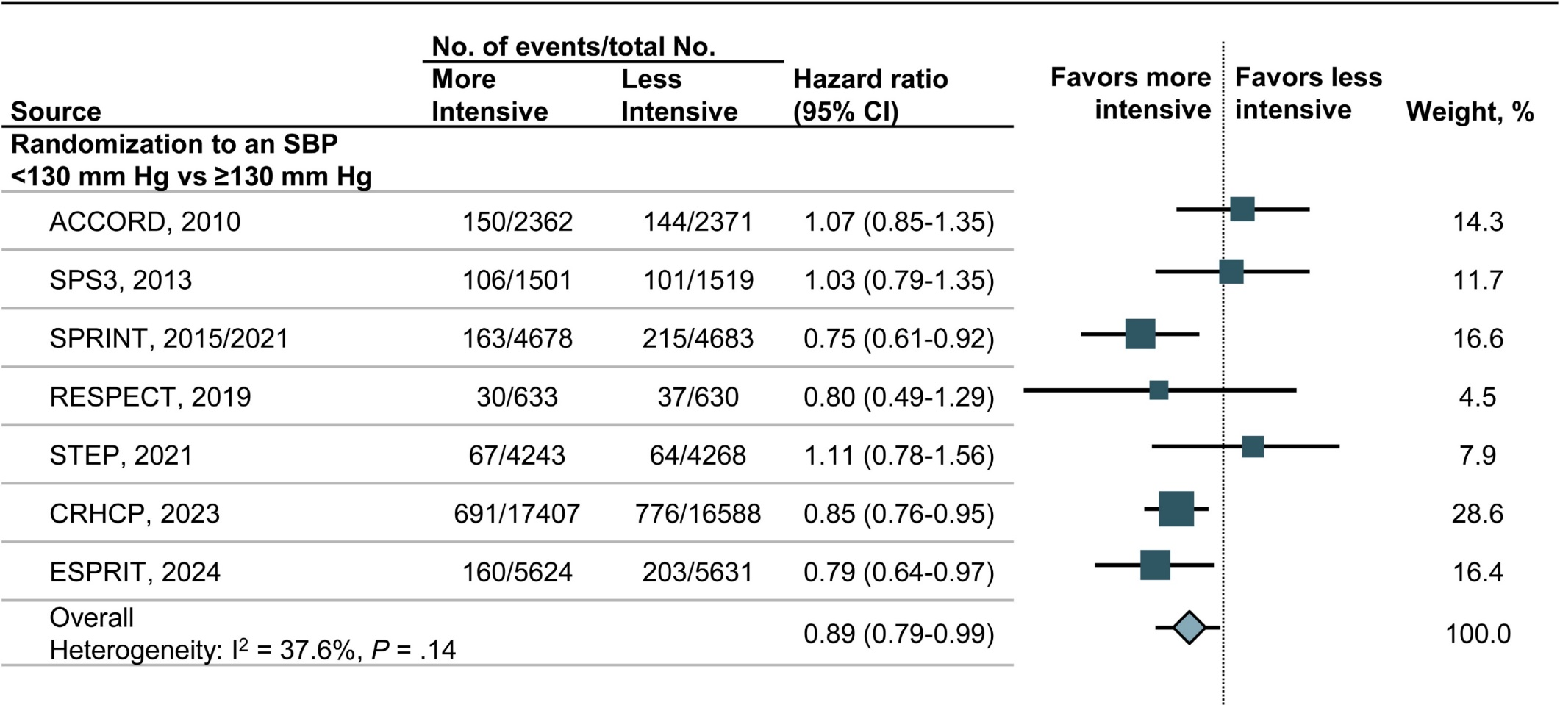
Why recommend a SBP < 130 mmHg target?
CV Events
Mortality (all causes)
Whelton, Hypertension 2024

Slide 24
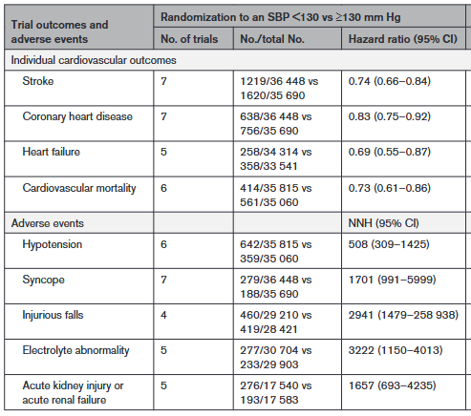
Why recommend a SBP < 130 mmHg target?
Potential harms of more intensive BP lowering are quite low.
Whelton, Hypertension 2024

Slide 25
TREATMENT (2)
Recommendation | Strength of recommandation | Certainty of the evidence
For adults with hypertension requiring pharmacotherapy, low-dose combination therapy (ideally as a single-pill combination) is recommended as initial treatment, which includes drugs from 2 of the following 3 complementary classes of medications: ACEIs or ARBs, thiazide or thiazide-like diuretics, and long-acting dihydropyridine CCBs. | Strong | Moderate
If BP remains above target despite 2-drug combination therapy, 3-drug combination therapy consisting of an ACEI or ARB, a thiazide or thiazide-like diuretic, and a long-acting dihydropyridine CCB is recommended. | Strong | Moderate

Slide 26
Potential benefits of combination therapy
70% of patients need more than one class of drug
Additional 4 mm Hg reduction vs. two separate agents
32% more patients with controlled hypertension
Lower risk of of side effects
Better adherence and persistence of treatment
Lower risk of hospitalization, cardiovascular events, and mortality
Economic benefits
No increase in the risk of discontinuation compared to separate agents or monotherapy

Slide 27
TREATMENT (3)
Recommendation | Strength of recommandation | Certainty of the evidence
If BP remains above target despite 3-drug combination therapy consisting of an ACEI or ARB; a thiazide or thiazide-like diuretic; and a long-acting dihydropyridine CCB at their maximally tolerated doses, the addition of spironolactone is suggested. | Conditional | Moderate

Slide 28
Particularities
Not intended for the treatment of people who are pregnant, planning to become pregnant, or breastfeeding, or children.
All people with hypertension must now be treated
  A large proportion of the "new hypertensions" should only be treated by a non-pharmacological approach
Identical treatment target for all patients
  The level of BP and the presence of CV risk factors determines the threshold for initiation of pharmacotherapy
Individualization of treatment remains important
  Considered goals of care, frailty, risk of falling, and orthostatic hypotension
  Aim for as low BP as possible if the target cannot be achieved
  Possibility of aiming for a systolic BP < 120 mm Hg in people at very high cardiovascular risk

Slide 29
Particularities
Thiazide diuretics (HCTZ) and thiazide-type diuretics (chlorthalidone or indapamide) are again considered equivalent from the point of view of anti-hypertensive effect and cardiovascular protection
  Based on the results of a large randomized-controlled study (Ishani, NEJM 2024)
  However, the Committee believes that agents with a longer duration of action should be given priority as far as possible
Beta-blockers are no longer recommended in the absence of a specific indication
Absence of diastolic BP target
  Benefits of reducing diastolic BP when systolic BP is < 130 mm Hg is uncertain (isolated diastolic hypertension)

Slide 30
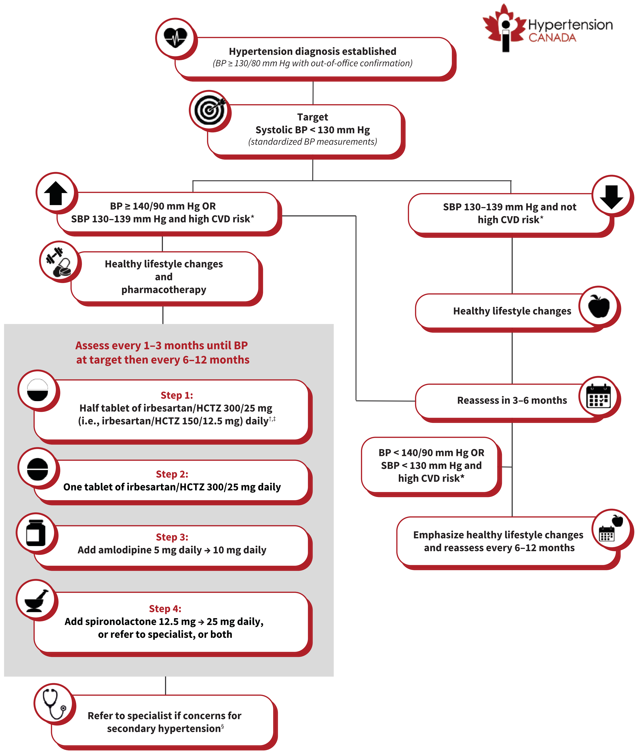
Implementation Tool
Notes:
Suggested algorithm for the treatment of hypertension in primary care (not intended for use in pregnancy). Note: BP = blood pressure, CVD = cardiovascular disease, eGFR = estimated glomerular filtration rate, HCTZ = hydrochlorothiazide, SBP = systolic blood pressure. *High CVD risk conditions include established CVD (coronary artery disease, heart failure, cerebrovascular disease, and peripheral artery disease), type 1 or type 2 diabetes mellitus, chronic kidney disease (eGFR < 60 mL/min/1.73 m² or albuminuria ≥ 3 mg/mmol), 10-year Framingham Risk Score ≥ 20%, (62) and age ≥ 75 years. †Initial single-pill combination therapy is preferred if available and covered. If not, 2 separate pills can use used as an alternative, with preference for a long-acting thiazide-like diuretic over a thiazide diuretic. If patient is at high risk of symptomatic hypotension, treatment initiation with a single agent is reasonable. Angiotensin-converting enzyme inhibitors and angiotensin II receptor blockers should be avoided or discontinued in all people who are pregnant or trying to become pregnant. ‡See Table 3 for acceptable alternative single-pill combinations available in Canada. §Includes unexplained, sudden worsening of hypertension, hypokalemia, adrenal nodule, abdominal bruit, acute kidney injury after hypertension treatment, severe or malignant hypertension, hypertension at a young age, and resistant hypertension.

Slide 31
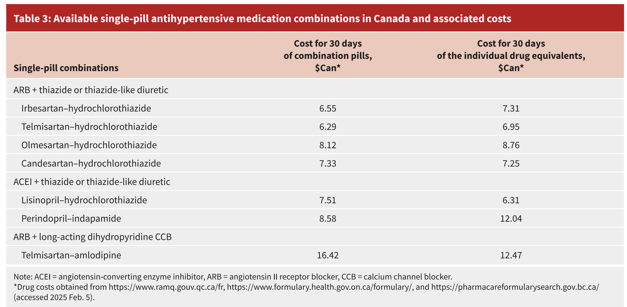
Acceptable alternatives

Slide 32
Advantages of a standardized processing algorithm?
Proven strategies through HEARTS
Better BP reduction
"Bulk" purchasing and cost reduction
Standardizes care
Facilitates education initiatives

Slide 33

Answers to common questions are available in Appendix 2
What is the justification for lowering the diagnostic threshold of hypertension to ≥130/80 mmHg and the treatment target to < 130 mmHg
Why is only one threshold provided for office, ambulatory, and home BP measurements?
Should treatment be initiated in all people with hypertension regardless of their cardiovascular risk?
Why is there no recommendation regarding a diastolic BP target?
Is the treatment algorithm and/or target for elderly individuals (>80 years)?
Why is the BP target in individuals at high risk of cardiovascular disease not < 120 mmHg?
Should all people treated for hypertension be switched to the recommended regimen?
Why are specific drugs suggested in the treatment algorithm, rather than drug classes?
Could starting a single-pill combination lead to excessive BP reduction?
What is the justification underlying the choice of irbesartan/HCTZ as a first-line treatment?
Can irbesartan/HCTZ pills be cut in half?
Why is an angiotensin receptor blocker suggested over an angiotensin-converting enzyme inhibitor?
Why is a single pill combination including HCTZ recommended whereas the prior guidelines recommended favoring long-acting thiazides such as indapamide and chlorthalidone?
What is the place of betablockers in hypertension treatment?
Are routine blood tests recommended for all people who start combination therapy and/or after each dosage change?
Will recommending specific antihypertensive drugs lead to back-order issues?
How were conflicts of interests managed regarding drug selection?

Slide 34
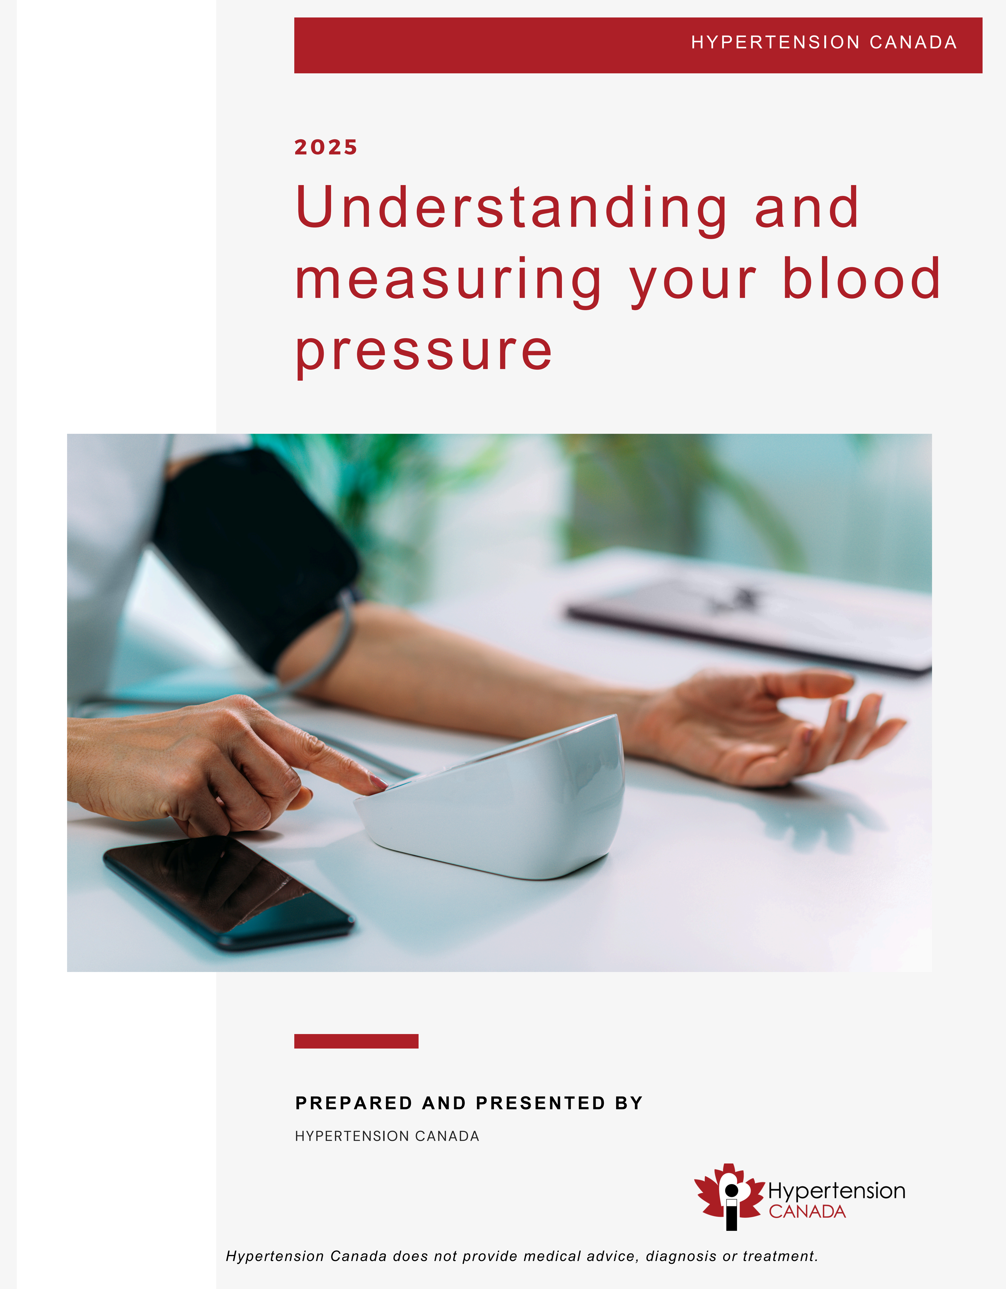
Public Guideline
Created for and by patients
Focuses on topics that are important to patients, where they can take action
Aims to help them make decisions that are beneficial to their BP and to be actively involved in their care

Slide 35
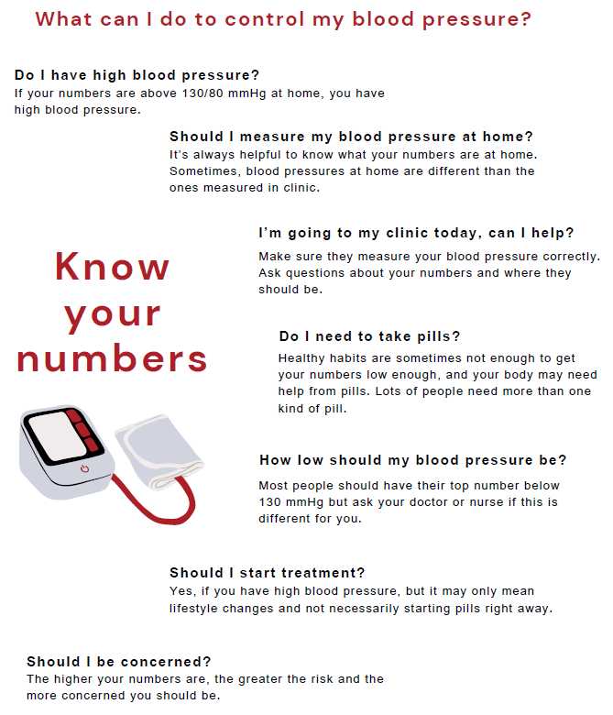
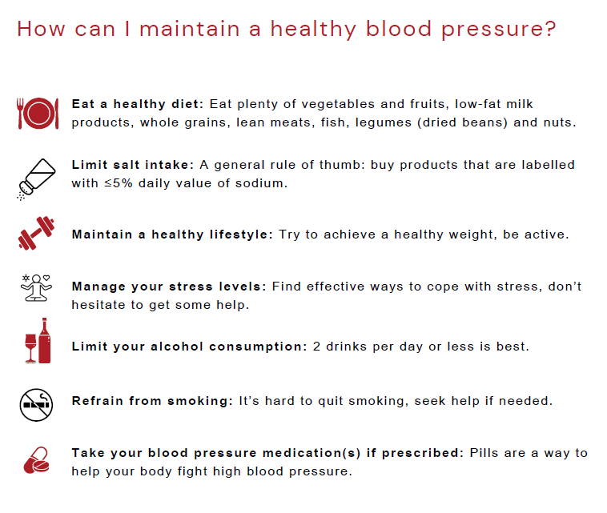

Slide 36
Priority setting exercise: Completed in 2025
Comprehensive Guideline: 2025-2028
Topics to vary from year to year, depending on the priority given to them
"Living" guidelines hosted on the Hypertension Canada website and an app
Recommendations based on data reviews by independent groups, in collaboration with Hypertension Australia

Slide 37
Key messages
This is only the first step of the new Guidelines process
Importance of optimal BP measurements is key
New hypertension diagnosis threshold: 130/80 mm Hg for all
Treat everyone, but some only with non-pharmacological measures
If BP > 140/90 mm Hg or SBP 130-139 mmHg and high CV risk, start pharmacotherapy without waiting for the effects of non-pharma measures
Low-dose combination therapy as first line treatment
Spironolactone as 4th line agent

Slide 38
Acknowledgements
Primary Care Guidelines Committee Members
  R. Goupil (co-chair), G. Hundemer (co-chair), R. Tsuyuki, N. Santesso, K. Terenzi, J. Habert, G. Cheng, S Gysel, J. Bruneau, A. Leung, N. Campbell, E. Schiffrin
Patient Guidelines Committee Members
  K. Eady, J.K. Laughton, K. Moffat, R. Rajasingham
Patient Reviewers of Recommendations
  C. Allard, L. Edwards, R.L. Lohaza, D. Macpherson, R.M. Wiebe

Slide 39
Questions?

