Slide 1
The 2016 CHEP Guidelines
What’s new in the treatment of hypertension?
What’s still really important?

Slide 2
Presenter Disclosure
Relationships with commercial interests (Padwal):
  Grants/Research Support: CIHR, AIHS, University of Alberta Hospital Foundation, Novo Nordisk, Valencia Technologies
  Speakers Bureau/Honoraria: Merck, Servier
  Consulting Fees: Amgen, Servier
  Data Safety and Monitoring: Prometic

Slide 3
Mitigating Potential Bias
  The information presented is based on recent information that is explicitly ‘‘evidence-based’’.
  This presentation and all the recommendations involving clinical medicine are based on evidence that was vetted by the Canadian Hypertension Education Program. The presentation has been developed for dissemination by Hypertension Canada.

Slide 4
Hypertension Canada
Mission:
  Advancing health through the prevention and control of high blood pressure and its complications.
Vision:
  Canadians will have the healthiest blood pressure
  in the world.

Slide 5
Evidence-based Annual Guidelines
Canada has the world’s highest reported national blood pressure control rates
CHEP is known as the most credible source for evidence-based hypertension guidelines, with annual updates, a well-validated review process and effective dissemination techniques across Canada

Slide 6

2016 CHEP Guidelines Task Force

Slide 7
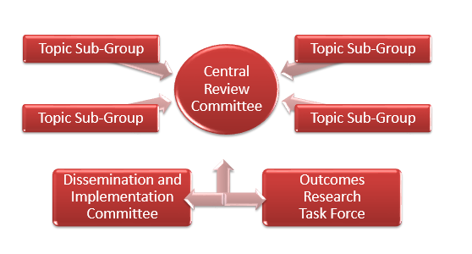
CHEP Guidelines
Organizational Chart
Guidelines Task Force
Topic
Sub-Group

Slide 8
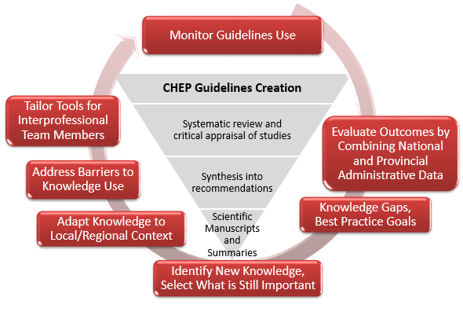
Hypertension Canada’s Annual KT Cycle for developing management guidelines
Dissemination and Implementation Committee
Outcomes Research Task Force

Slide 9
CHEP 2016 Guidelines
What’s new?
New thresholds and targets for high risk patients (SPRINT)
Assessing clinic blood pressures using automatic electronic (oscillometric) monitors
Adopting healthy behaviours is integral to the management of hypertension (focus on potassium supplementation)
Updating the evaluation of patients with suspected secondary forms of hypertension (focus on primary hyperaldosteronism)
Updating the treatment of patients with hypertension with concurrent coronary artery disease
New recommendations on the diagnosis and management of hypertension in pediatric patients (NOT the focus of this presentation)

Slide 10
CHEP 2016 Guidelines
What’s still important?
The diagnosis of hypertension should be based on out-of-office measurements
The management of hypertension is all about global cardiovascular risk management and vascular protection
The most important step in prescription of antihypertensive therapy is achieving patient “buy-in” and adherence

Slide 11

Usual Office BP Threshold Values for Initiation of Pharmacological Treatment
Population | SBP | DBP
High Risk (SPRINT population) | >130 | NA
Diabetes | >130 | >80
Moderate-to-high risk (TOD or CV risk factors)* | >140 | >90
Low risk (no TOD or CV risk factors) | >160 | >100
TOD = target organ damage
*AOBP threshold >135/85

Slide 12
Recommended Office BP Treatment Targets
Treatment consists of health behaviour ± pharmacological management
Population | SBP | DBP
High Risk | <120 | NA
Diabetes | < 130 | < 80
All others (including CKD)* | < 140 | < 90
* Target BP with AOBP < 135/85
Notes:
The higher treatment target for the very elderly reflects current evidence and
heightened concerns of precipitating adverse effects, particularly in frail patients. Decisions regarding initiating and intensifying pharmacotherapy in the very elderly should be based upon an individualized risk-benefit analysis.

Slide 13
New thresholds/targets for the high risk patient post-SPRINT: who does this apply to??
Clinical or sub-clinical cardiovascular disease
OR
Chronic kidney disease (non-diabetic nephropathy, proteinuria <1 g/d, *estimated glomerular filtration rate 20-59 mL/min/1.73m²)
OR
†Estimated 10-year global cardiovascular risk ≥15%
OR
Age ≥ 75 years
Patients with one or more clinical indications should consent to intensive management.
* Four variable MDRD equation
† Framingham Risk Score, D'Agastino, Circulation 2008

Slide 14
New thresholds/targets for the high risk patient post-SPRINT: who does this NOT apply to??
Limited or No Evidence:
Heart failure (EF <35%) or recent MI (within last 3 months)
Indication for, but not currently receiving a beta-blocker
Frail or institutionalized elderly
Inconclusive Evidence:
Diabetes mellitus
Prior stroke
eGFR < 20 ml/min/1.73m2
Contraindications:
Patient unwilling or unable to adhere to multiple medications
Standing SBP <110 mmHg
Inability to measure SBP accurately
Known secondary cause(s) of hypertension

Slide 15
SPRINT: SBPs achieved
Average no. of medications
Intensive care: 2.8
Standard care: 1.8
The SPRINT Research Group, NEJM, Nov 9th, 2015

Slide 16
Primary Outcome
NNT=61
The SPRINT Research Group, NEJM, Nov 9th, 2015

Slide 17
New Guideline post-SPRINT
New 2016
For high-risk patients, aged ≥ 50 years, with systolic BP levels >/=130 mm Hg, intensive management to target a systolic BP </=120 mm Hg should be considered.
Intensive management should be guided by automated office BP measurements.
Patient selection for intensive management is recommended and caution should be taken in certain high-risk groups.

Slide 18
CHEP 2016 Guidelines
What’s new?
New thresholds and targets for high risk patients (SPRINT)
Assessing clinic blood pressures using automatic electronic (oscillometric) monitors
Adopting healthy behaviours is integral to the management of hypertension (focus on potassium supplementation)
Updating the evaluation of patients with suspected secondary forms of hypertension (focus on primary hyperaldosteronism)
Updating the treatment of patients with hypertension with concurrent coronary artery disease
New recommendations on the diagnosis and management of hypertension in pediatric patients (NOT the focus of this presentation)

Slide 19
Office BP Measurement Methods
Office (attended):
  Auscultatory (mercury, aneroid) – not recommended
  Non-automated oscillometric (electronic)
Automated office (unattended): AOBP
  Oscillometric (electronic)

Slide 20
2015 Recommendation on BP Measurement
New 2015
AOBP:
Measurement using electronic (oscillometric) devices in the upper arm
Provider outside the room/area (mitigates white coat effect)
Multiple readings
Mean automatically calculated

Slide 21
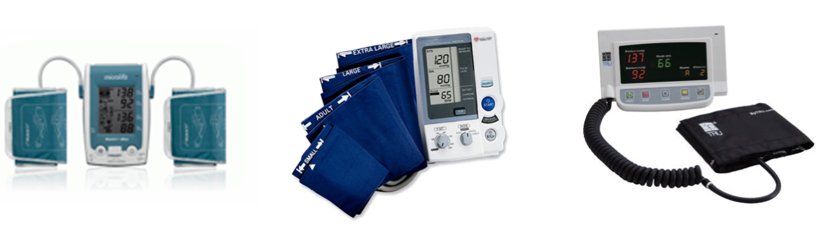
New 2016 Recommendation
BP Measurement
Automated office blood pressure (AOBP) is the preferred method of performing in-office BP measurement.
Automated Office (unattended, AOBP)
Oscillometric (electronic)

Slide 22
Comparison of Automated Office, Ambulatory and Pharmacy BP measurements
AOBP is Not Affected by the Setting in Which BP is Recorded
Readings recorded in an ABPM unit or in an office waiting room are similar to AOBP recorded in a physician’s examination room
Myers MG, et al. Blood Press Monit 2009;14:108-11
Greiver M, et al. Blood Press Monit 2012;17:137-8
Armstrong D, et al. Blood Press Monit 2015;20:204-8
• AOBP results obtained in the pharmacy were comparable
with AOBP results from the physician’s office
Chambers LW, et al. CMAJ Open 2013;1:E37-42

Slide 23
Comparisons of blood pressure readings obtained in clinical settings using different methods of blood pressure measurement
 | Mean blood pressure* (mmHg)
 | Centre for Studies in Primary Care₁ | ABPM referral unit₂ | CAMBO trial₃
Routine manual office BP | 151/83 | 152/87 | 150/81
Automated office BP | 140/80 | 132/75 | 135/77
Awake ambulatory BP | 142/80 | 134/77 | 133/74
*The automated office blood pressure (BP) and awake ambulatory BP were similar, and both were lower than the routine manual BP obtained in community practice.
1. Beckett L et al , BMC Cardiovasc. Disord. 2005; 5: 18. 2. Myers MG et al, J. Hypertens. 2009; 27: 280. 3. Myers MG, et al. BMJ 2011; 342: d286.
Notes:
42% had at least one hypertensive reading in usual care versus stand nurse

Slide 24
Predictive value of AOBP
AOBP predicts end-organ damage
Systolic AOBP correlates with LVMI similarly to awake ABPM
AOBP and 24-h ABPM have similar predictive ability for microalbuminuria
AOBP is more strongly associated with cIMT (compared to OBPM)
cIMT: Carotid Intima Media Thickness
LVMI: Left Ventricular Mass Index
Campbell NRC, et al. J Hum Hypertens 2007;21:588-90; Andreadis EA, et al. Am J Hypertens 2011;24:661-6; Andreadis EA, et al. Am J Hypertens 2012;25:969-73.
Notes:
Preliminary data have become available linking AOBP with target organ damage. Andreadis et al30 have recently
reported that systolic AOBP correlated with left ventricular mass index (r = 0.37) as strongly as AABP did (r = 0.37). A
clinic reading taken in the presence of research staff correlated poorly with left ventricular mass index (r = 0.12). In
an earlier study,1 routine MOBP recorded in primary care practice also correlated poorly (r = 0.06) with left ventricular
mass index, whereas a manual BP reading recorded in the same setting for research purposes showed a substantially
stronger correlation (r = 0.27). Automated office BP measurement has also been shown to correlate better
with carotid artery intima-media thickness compared with manual BP readings.36

Slide 25
Predictive value of AOBP
The CHAP Study
AOBP Predicts Cardiovascular Events
3627 community-dwelling residents, aged >65 yrs, untreated for hypertension – part of the CHAP trial
BpTRU® device in community pharmacies
f/u 4.9 ± 1.0 yrs for fatal and non-fatal CV events
Myers MG, et al. Hypertension 2015;66:489-95. Kaczorowski J, et al. 2008 Preventive Medicine 46: 537–544
Notes:
September issue of Hypertension
The Cardiovascular Health Awareness Program (CHAP) was a BP screening program in which community-dwelling residents
in Ontario over age 65 years had their BP recorded in a local pharmacy using the same standard AOBP procedures
used as in the above-mentioned pharmacy study.
Kaczorowski J, Chambers LW, Dolovich L, et al. Improving cardiovascular health at population level: 39 community cluster randomised trial of Cardiovascular Health Awareness Program (CHAP). BMJ. 2011;342:d442.

Slide 26
Predictive value of AOBP
Cardiovascular Events
Systolic Blood Pressure
Diastolic Blood Pressure
Syst BP | Hazard Ratio
< 110 | 1.35 (0.8-2.3)
110-119 (referent) | 1.00
120-129 | 1.08 (0.7-1.7)
130-139 | 1.30 (0.9-2.0)
135-144 | 1.66 (1.1-2.5)
140-149 | 1.79 (1.2-2.8)
150-159 | 1.96 (1.2-3.2)
160+ | 2.06 (1.3-3.4)
Diast BP | Hazard Ratio
< 60 | 1.06 (0.6-1.9)
60-69 (referent) | 1.00
70-79 | 1.15 (0.8-1.6)
80-89 | 1.72 (1.2-2.5)
90 + | 2.07(1.3-3.2)
Myers MG, et al. Hypertension 2015;66:489-95.
Notes:
Adjusted hazard ratios with 95% confidence intervals according to category of systolic blood pressure (BP).
271 CV events – 208 non-fatal and 63 fatal

Slide 27
CHEP 2016 Guidelines
What’s new?
New thresholds and targets for high risk patients (SPRINT)
Assessing clinic blood pressures using automatic electronic (oscillometric) monitors
Adopting healthy behaviours is integral to the management of hypertension (focus on potassium supplementation)
Updating the evaluation of patients with suspected secondary forms of hypertension (focus on primary hyperaldosteronism)
Updating the treatment of patients with hypertension with concurrent coronary artery disease
New recommendations on the diagnosis and management of hypertension in pediatric patients (NOT the focus of this presentation)

Slide 28
Health Behaviour Management
Intervention | Target
Reduce foods with added sodium | → 2000 mg /day
Weight loss | BMI <25 kg/m²
Alcohol restriction | < 2 drinks/day
Physical activity | 30-60 minutes 4-7 days/week
Dietary patterns | DASH diet
Smoking cessation | Smoke free environment
Waist circumference | Men < 102 cm Women < 88 cm
Potassium supplementation | NEW RECOMMENDATION
Notes:
Note: the extent of blood pressure change from each intervention should not be compared because the participants, the type and duration of intervention, and the basic design of the trials differed substantially.

Slide 29
New 2016 Recommendation:
Health Behaviours
Potassium intake:
In patients not at risk of hyperkalemia, increase dietary potassium intake to reduce blood pressure.

Slide 30
Systematic Reviews showing a Significant Effect of Potassium on BP
Author | Year | RCTs | Total N | Pooled effect SBP | Pooled effect DBP | Notes
Cappuccio | 1991 | 19 | 586 | -5.9 (-6.6 to -5.2) | -3.4 (-4.0 to -2.8) | Mixed status, 5-112 days, 10-150 participants; ?all RCTs
Whelton | 1997 | 33 | 2609 | -3.11 (-4.3 to -1.9) | -1.97 (-3.4 to -0.5) | Mixed status; 4d-3yrs; 10-484 N
Geleijnse | 2003 | 27 | NR | -2.4 (-3.8 to -1.1) | -1.57 (-2.6 to -0.5) | Mixed status; >2 wks duration
Dickinson | 2006 | 5 | 425 | -3.9 (-8.6 to 0.8) -11.2 (-25.2 to 2.7) | -1.5 (-6.2 to 3.1) -5.0 (-12.5 to 2.4) | Cochrane; hypertensive only; >8wks; 12-212 N; still significant heterogeneity; one trial not pooled – no ss dec in BP
van Bommel | 2012 | 10 | 563 | -7.12 (-8.5 to -5.7) -9.5 (-10.8 to -8.1) | -4.9 (-5.8 to -4.0) -6.4 (-7.3 to – 5.6) | Hypertensive pts with high Na diet; heterogeneity dec. after exc. of outlier
Aburto | 2013 | 22 | 1606 | -3.49 (-5.2 to -1.8) | -1.96 (-3.1 to -0.9) | Mixed status; >4 wks; measured urinary K
Binia | 2015 | 15 | 917 | -4.7 (2.4 to -7) | - 3.5 (1.3 to 5.7) | Pts not on anti-htn Rx; mixed status; >=4wks;

Slide 31
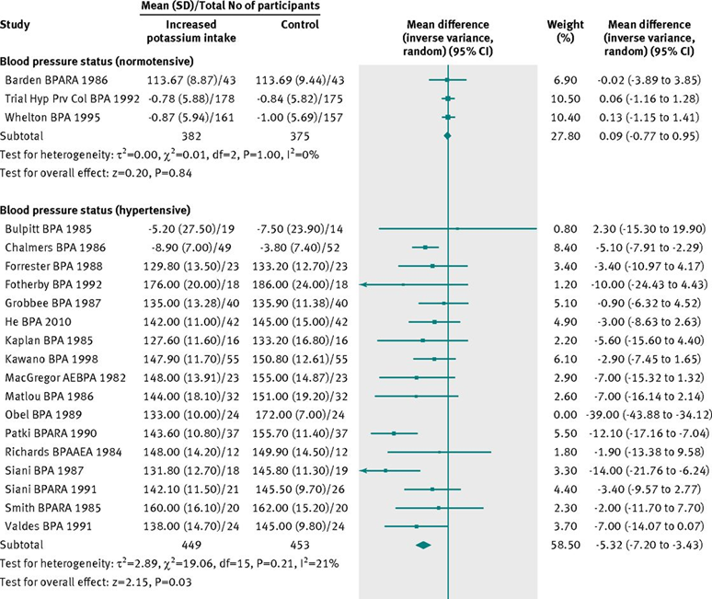

Increased Potassium intake decreases BP:
Effect of increased potassium intake on cardiovascular risk factors and disease: systematic review and meta-analyses. Aburto et al, BMJ 2013.
Notes:
-WHO commissioned SR of RCTs comparing higher vs. lower K >= 4weeks
-All studies must have haad measured urinary K excretion
-Conclusion of effectiveness was of moderate to high quality per GRADE
-Findings for DBP similar

Slide 32
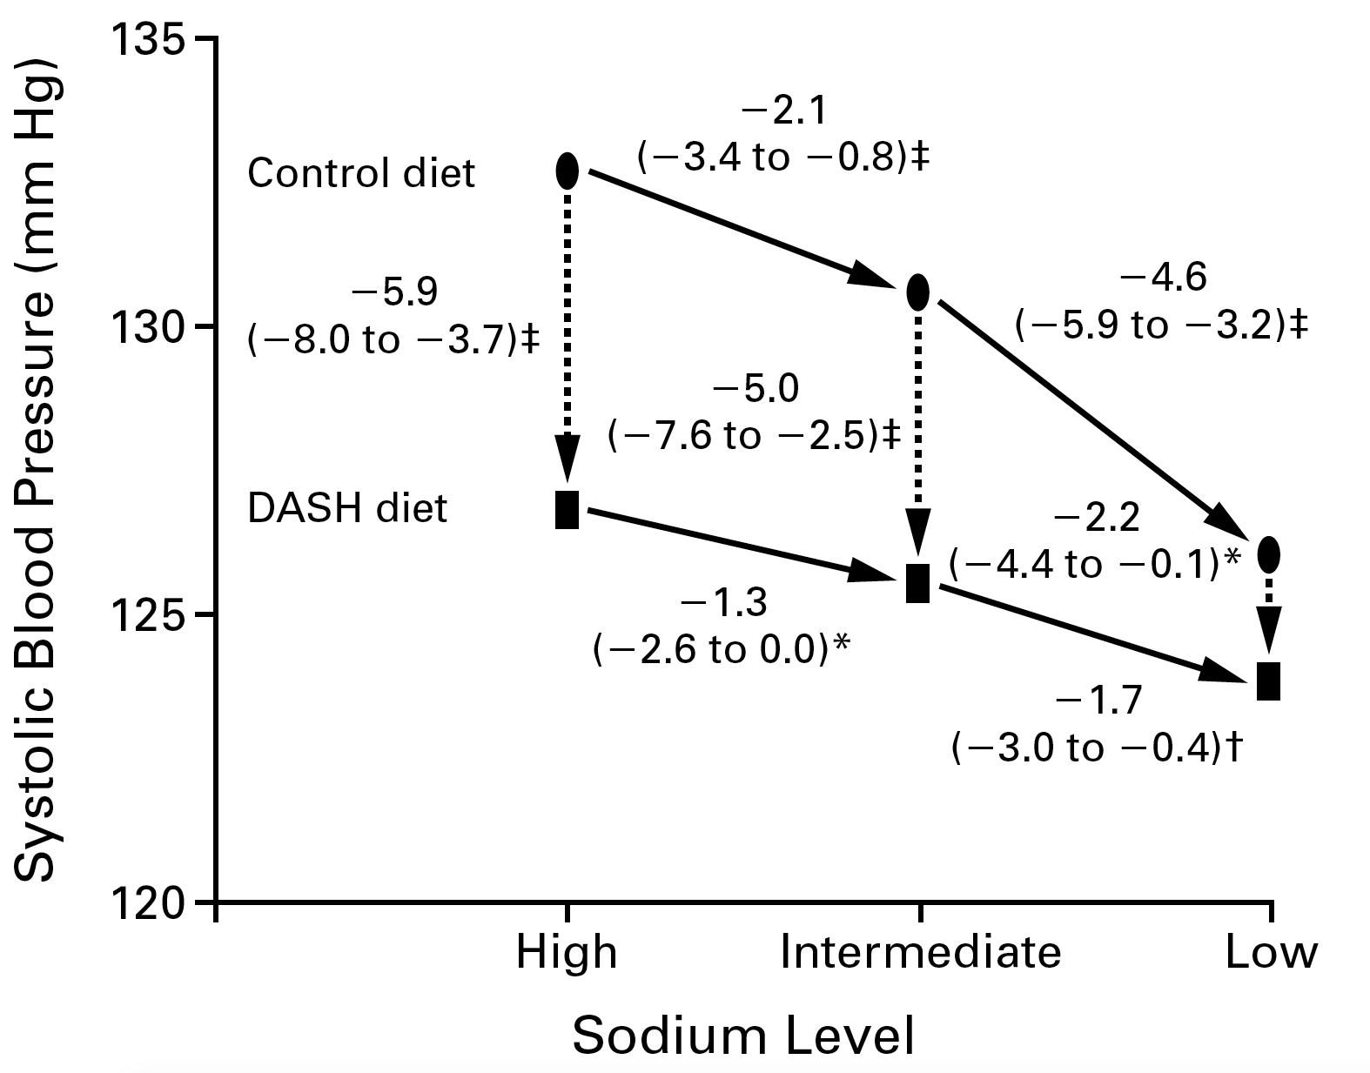
A K rich diet has additive effects to
Na restriction
Sacks et al. N Engl J Med, Vol. 344, No. 1 · January 4, 2001

Slide 33
Enriching dietary potassium lowers BP: summary
Potassium supplementation leads to a decrease in BP
Effect most consistently seen in patients with hypertension
Effect of K is modified by Na intake, with greater effect at higher baseline Na

Slide 34
Risk of Hyperkalemia with K Supplementation
Identify those at Risk of Hyperkalemia with Potassium supplementation
Prior to advising increase in potassium intake, the following kinds of patients – who are at high risk of hyperkalemia, should be assessed for suitability, and monitored closely:
Patients taking renin-angiotensin-aldosterone inhibitors
Patients on other drugs that can cause hyperkalemia (trimethoprim and sulfamethoxazole, amiloride, triamterene)
Patients with CKD (GFR < 45mL/min)
Patients with baseline serum potassium > 4.5 mmol/L

Slide 35
CHEP 2016 Guidelines
What’s new?
New thresholds and targets for high risk patients (SPRINT)
Assessing clinic blood pressures using automatic electronic (oscillometric) monitors
Adopting healthy behaviours is integral to the management of hypertension (focus on potassium supplementation)
Updating the evaluation of patients with suspected secondary forms of hypertension (focus on primary hyperaldosteronism)
Updating the treatment of patients with hypertension with concurrent coronary artery disease
New recommendations on the diagnosis and management of hypertension in pediatric patients (NOT the focus of this presentation)

Slide 36
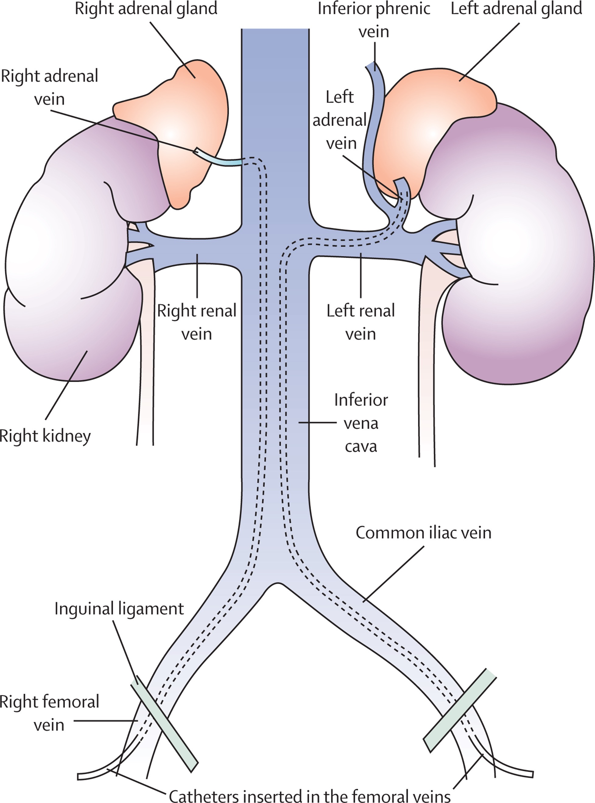
New 2016 Recommendation:
Endocrine Hypertension
In patients with primary hyperaldosteronism and a definite adrenal mass who are eligible for surgery, adrenal venous sampling (AVS) is recommended to assess for lateralization of aldosterone secretion. AVS should be performed exclusively by experienced teams working in specialized centres.
adapted from Monticone S et al. The Lancet
Volume 3, No. 4, p296–303, April 2015
DOI: http://dx.doi.org/10.1016/S2213-8587(14)70069-5

Slide 37
Role for adrenal venous sampling in primary aldosteronism
Cohort of 203 patients from Mayo Clinic with PA, receiving CT and AVS
41% of those with normal CT had unilateral hypersecretion
Only 51% of those with unilateral micronodules (<1 cm) had ipsilateral hypersecretion; 66% of those with unilateral macronodules (>1 cm) had ipsilateral hypersecretion
15% with micronodules and 3% with macronodules had contralateral hypersecretion
49% with bilateral micronodules and 33% with bilateral macronodules had unilateral hypersecretion
CT alone would incorrectly exclude 21% of patients for surgery
Based on CT alone, 25% would have received unnecessary surgery
Young WF, et al. Surgery. 2004 Dec;136(6):1227-35.

Slide 38
CHEP 2016 Guidelines
What’s new?
New thresholds and targets for high risk patients (SPRINT)
Assessing clinic blood pressures using automatic electronic (oscillometric) monitors
Adopting healthy behaviours is integral to the management of hypertension (focus on potassium supplementation)
Updating the evaluation of patients with suspected secondary forms of hypertension (focus on primary hyperaldosteronism)
Updating the treatment of patients with hypertension with concurrent coronary artery disease
New recommendations on the diagnosis and management of hypertension in pediatric patients (NOT the focus of this presentation)

Slide 39
Change in 2016 Recommendation:
Hypertension in CAD
Prior recommendation:
For patients with stable angina, β-blockers are preferred as initial therapy. CCBs may also be used.
New recommendation:
For patients with hypertension and stable angina pectoris but without prior HF, MI or coronary artery bypass surgery, either a beta blocker or a calcium channel blocker can be used as initial therapy.

Slide 40
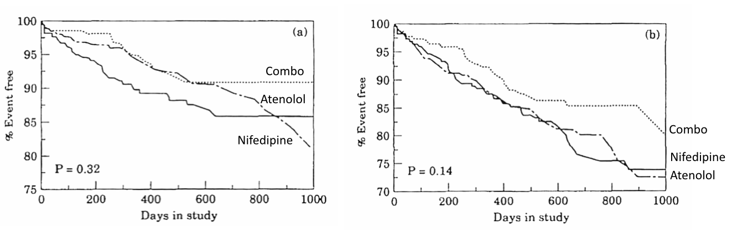
Beta blocker vs CCB in Treatment of CAD
The TIBET Trial
Events =MI, CV death, HF, ACS
Hard events + ischemic ST changes on 24 h ECG
Total Ischaemic Burden European Trial (TIBET): Effects of atenolol (N=226), nifedipine SR (N=232) or combination (N=224) on outcome in chronic stable angina. Dargie et al. EHJ 1996;17:104-112

Slide 41
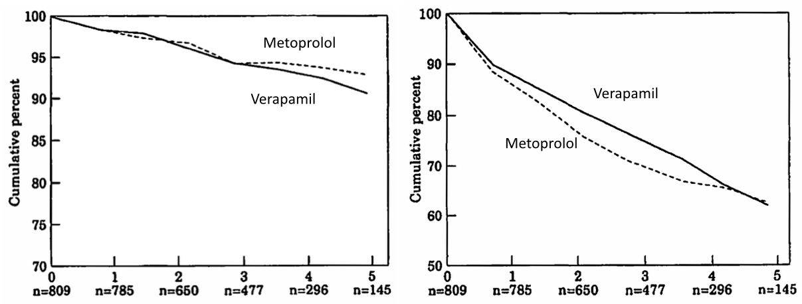
Beta blocker vs. CCB in treatment of CAD
The APSIS Trial
Cumulative percentage survival
Cumulative event free survival
Fatal events
Non Fatal
The curves were not extended beyond 5 years as few patients were followed thereafter
APSIS: metoprolol vs verapamil in stable angina pectoris
No difference: CV events (30.8% v 29.3%) CV mortality 4.7% vs 4.7%), Non-fatal CV events 26.1 v 24.3%
Hjemdahl P. et al. Favourable long term prognosis in stable angina pectoris: an extended follow up of the angina prognosis study in Stockholm (APSIS); Heart 2006;92:177-182

Slide 42
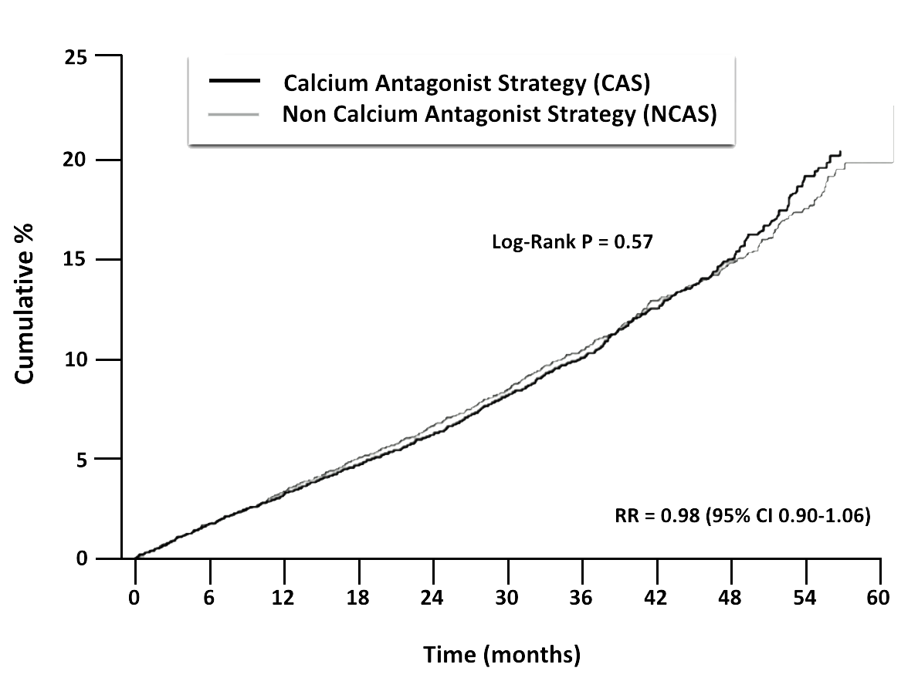
CCB vs. Non-CCB in treatment of CAD
The INVEST trial
As required to achieve
blood pressure control:
CCB strategy:
Verapamil sustained release + Trandolapril + HCTZ
Non-CCB strategy:
Atenolol + HCTZ, + Trandolapril
- 22,000 HT patients with CAD
- Primary Outcome:
Alive, Free of MI or Stroke
- Total FU: 61,807 pt-y, mean FU 2.7y,
- Annual event rate = 3.6%
Pepine JC et al. JAMA 2003 290(21):2805-16

Slide 43
CHEP 2016 Guidelines
What’s still important?
The diagnosis of hypertension should be based on out-of-office measurements
The management of hypertension is all about global cardiovascular risk management and vascular protection
The most important step in prescription of antihypertensive therapy is achieving patient “buy-in” and adherence

Slide 44
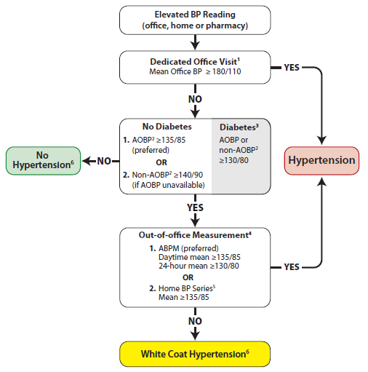
Hypertension diagnostic algorithm
Out of office assessment is the preferred means of hypertension Dx
Measurement using electronic (oscillometric) upper arm devices is preferred over auscultation
ABPM: Ambulatory Blood Pressure Measurement
AOBP: Automated Office Blood Pressure
Notes:
Notes:
If AOBP is used, use the mean calculated and displayed by the device. If non-AOBP (see note 2) is used, take at least three readings, discard the first and calculate the mean of the remaining measurements. A history and physical exam should be performed and diagnostic tests ordered.
AOBP = Automated Office BP. This is performed with the patient unattended in a private area.
Non-AOBP = Non-automated measurement performed using an electronic upper arm device with the provider in the room.
Diagnostic thresholds for AOBP, ABPM, and home BP in patients with diabetes have yet to be established (and may be lower than 130/80 mmHg).
Serial office measurements over 3-5 visits can be used if ABPM or home measurement not available.
Home BP Series: Two readings taken each morning and evening for 7 days (28 total). Discard first day readings and average the last 6 days.
Annual BP measurement is recommended to detect progression to hypertension.

Slide 45
Out-of-Office BP Measurements
ABPM has better predictive ability than OBPM and is the recommended out-of-office measurement method.
HBPM has better predictive ability than OBPM and is recommended if ABPM is not tolerated, not readily available or due to patient preference.
Identifies white coat hypertension and masked hypertension.

Slide 46
Out-of-office BP measurements are more highly correlated with BP-related risk
LVH
Albumin excretion ratio
SBP
SBP
DBP
DBP
Indexes of hypertensive target organ damage
Indexes of hypertensive target organ damage
Value of Home Blood Pressures as Predictor of Target Organ Damage in Mild Arterial Hypertension
Mulè G. et al. J Cardiovasc Risk 2002;9:123-9.
Notes:
Correlation Between Target Organ Damage and OBP, Self BP, and ABPM
The correlation between target organ damage, such as LVH and albumin excretion ratio was weaker with office BP (OBP) and stronger with ABPM. The correlation with self (home) BP was higher than with OBP, but less than with ABPM, for both systolic and diastolic BP.

Slide 47
White Coat and Masked Hypertension
200
180
MASKED
HYPERTENSION
TRUE
HYPERTENSION
160
Ambulatory BP mmHg
140
135
120
WHITE COAT
HYPERTENSION
NORMOTENSION
100
100
120
140
160
180
200
Manual Office BP mmHg
Adapted from CHEP. www.hypertension.ca. Derived from Pickering et al. Hypertension 2002: 40: 795-796.
Notes:
Speaker’s notes
The addition of ABPM to conventional OBPM for defining BP status in clinical practice has added a layer of complexity to the process because the separation of normotension and hypertension can be assessed independently by each of the two methods. Only relying on OBPM risks missing cases of white coat or masked hypertension.¹
This slide depicts the four potential groups of patients who are:²
Normotensive by both methods (true normotensives)
Hypertensive by both methods (true or sustained hypertensives)
Hypertensive by OBPM and normotensive by ABPM (white coat hypertensives)
Normotensive by OBPM and hypertensive by ABPM (masked hypertensives)
From a clinical perspective, the first two groups are simple because both methods give the same classification. The last two groups are more complex because there is disagreement between the methods. Their distinction is important because white coat hypertensives are generally at low relative risk of CV morbidity, whereas masked hypertensives show more extensive target organ damage than true normotensives.²
References
Hypertension Canada. The 2015 Canadian Hypertension Education Program recommendations (2015 annual update). Available at www.hypertension.ca.
Pickering TG, et al. Masked hypertension. Hypertension 2002;40:795-6.

Slide 48
Criteria for the Diagnosis of
Masked Hypertension
 | BP (mm Hg)
Office BP | < 140/90
Awake Ambulatory | ≥ 135/85
24-hour Ambulatory BP | ≥ 130/80

Slide 49


Prevalence of Masked Hypertension
about
about
higher
10%
30%
in patients with
in the general population
in treated hypertensive
patients*
diabetes
and
chronic kidney
disease patients
One out of three treated hypertensive patients
has masked hypertension
*Andalib A et al. Int Med J 2012; 42:260-6
Notes:
Speaker’s notes
The estimated prevalence of masked hypertension (MH) as reported in prospective cohort studies varies. In the general population, the prevalence of MH is ~10% whereas the prevalence is higher in populations of treated hypertensive patients, reaching ~30%.1 The prevalence of MH is higher in patients with comorbidities including those with diabetes (up to 42.5%)2 and kidney disease (up to 32%).3
National and international registries suggest that when looking for MH within office-controlled patients, up to one in three could have MH.4
References
Peacock J et al. Unmasking masked hypertension: prevalence, clinical implications, diagnosis, correlates and future directions. J Hum Hypertens 2014; 28:521-8.
Franklin SS et al. Masked hypertension in diabetes mellitus: treatment implications for clinical practice. Hypertension 2013; 61(5):964-71.
Gorostidi M et al. Differences between office and 24-hour blood pressure control in hypertensive patients with CKD: A 5,693-patient cross-sectional analysis from Spain. Am J Kidney Dis 2013; 62(2):285-94.
Gorostidi M et al. Prevalence of white-coat and masked hypertension in national and international registries. Hypertens Res 2015; 38:1-7.

Slide 50
The prognosis of white coat
and masked hypertension
35
CV Events
30
25
20
CV events per 1000 patient-year
15
10
5
0
Normal
White coat
Uncontrolled
Masked
23/685
24/656
41/462
236/3125
Okhubo et al. J. Am. Coll. Cardiol. 2005;46;508-515

Slide 51
CHEP 2016 Guidelines
What’s still important?
The diagnosis of hypertension should be based on out-of-office measurements
The management of hypertension is all about global cardiovascular risk management and vascular protection
The most important step in prescription of antihypertensive therapy is achieving patient “buy-in” and adherence

Slide 52


Cardiovascular Risk Factors in Hypertensive Patients
8 out of 10 hypertensive patients
have at least 1 additional risk factor
Gee ME, Bienek A, McAlister FA, et al. Factors Associated With Lack of Awareness and Uncontrolled High Blood Pressure Among Canadian Adults With Hypertension. Can J Cardiol. 2012;28:375-382.

Slide 53
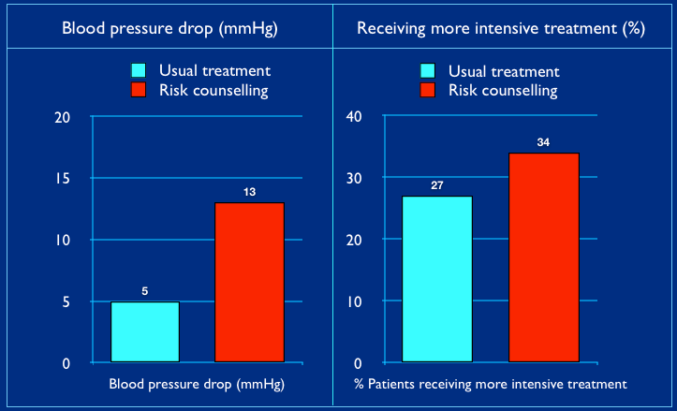
Impact of discussing coronary risk with patients on blood pressure treatment
Informing Patients of Their Global Risk improves BP Control
Cardiovascular Age™ www.myhealthcheckup.com
Grover SA, et al. J Gen Intern Med 2009;24(1);33-9.
Notes:
Notes:
Discussing Coronary Risk with Patients to Improve Blood Pressure Treatment - The CHECK-UP Study: A Randomized Controlled Trial - J Gen Intern Med 2009 Jan; Vol. 24 (1), pp. 33-9.
Results: There were 2,631 subjects who completed the study. Among 1,352 patients without diagnosed hypertension, 30% were above target on at least three consecutive visits. Among 1,279 individuals with known hypertension, 69% were above target on at least two consecutive visits. Overall, patients receiving risk profiles were more likely to receive appropriate antihypertensive therapy (OR = 1.40, 95% CI 1.11-1.78) compared to those receiving usual care. After adjustment for inter-physician variability and potential confounders, the use of the risk profile was associated with an increased likelihood of starting therapy (OR = 1.78, 95% CI 1.06-3.00) or modifying therapy (OR = 1.40, 95% CI 1.03-1.91).
Conclusions: In this clinical trial of dyslipidemia management, inadequately controlled hypertension was common, occurring in nearly 50% of individuals. Ongoing coronary risk assessment was associated with more appropriate blood pressure management. Cardiovascular risk assessment decision aids should be further evaluated in a randomized trial of hypertension therapy.

Slide 54
Vascular protection:
Statins for high risk hypertensive patients
Statins are recommended in high risk hypertensive patients based on having established atherosclerotic disease or at least 3 of the following:
Male
55 y or older
Smoking
Type 2 Diabetes
Total-C/HDL-C ratio of 6 or higher
Premature Family History of CV disease
Previous Stroke or TIA
LVH
ECG abnormalities
Albuminuria or CKD
Peripheral Vascular Disease
The Treatment of Hypertension is All About Vascular Protection
ASCOT-LLA Lancet 2003;361:1149-58

Slide 55
Vascular protection:
ASA for hypertensive patients
Low dose ASA in hypertensive patients
is recommended for patients >50 years
Caution should be exercised if BP is not controlled.
Hansson L, Zanchetti A, Carruthers SG, et al. Effects of intensive blood-pressure lowering and low-dose aspirin in patients with hypertension: principal results of the Hypertension Optimal Treatment (HOT) randomised trial. Lancet 1998;351:1755-1762.

Slide 56
Strong Evidence for Vascular Protection:
Smoking Cessation
New 2015
Tobacco use status of all patients should be updated on a regular basis and health care providers should clearly advise patients to quit smoking.
Advice in combination with pharmacotherapy (e.g., varenicline, bupropion, nicotine replacement therapy) should be offered to all smokers with a goal of smoking cessation.
Cochrane network meta-analysis 2014
Kate Cahill et al
Notes:
Cochrane network meta-analysis 2014, Kate Cahill et al
Nicotine replacement therapy, antidepressant bupropion, and nicotine receptor partial agonist varenicline (Champix)
Impact on long term abstinence- 6 months or longer
Synthesis of 12 Cochrane reviews
- 267 studies
- Over 10,000 participants

Slide 57
CHEP 2016 Guidelines
What’s still important?
The diagnosis of hypertension should be based on out-of-office measurements
The management of hypertension is all about global cardiovascular risk management and vascular protection
The most important step in prescription of antihypertensive therapy is achieving patient “buy-in” and adherence

Slide 58
Adherence in hypertensive patients
Adherence Can Be Improved by a Multi-Pronged Approach
Educate patients and patients' families about their disease/treatment regimens verbally and in writing
Use an interdisciplinary care approach coordinating with work-site health care givers and pharmacists if available
Healthcare practitioner-based telephone contact, particularly, over the first three months of therapy
Encourage greater patient responsibility/autonomy in regular monitoring of their blood pressure

Slide 59
Adherence in hypertensive patients
Adherence Can Be Improved by a Multi-Pronged Approach
Assess adherence to pharmacological and health behaviour therapies at every visit
Teach patients to take their pills on a regular schedule associated with a routine daily activity e.g. brushing teeth.
Simplify medication regimens using long-acting once-daily dosing
Utilize single pill combinations
Utilize unit-of-use packaging e.g. blister packaging

Slide 60
CHEP 2016 Guidelines
What’s new?
New thresholds and targets for high risk patients (SPRINT)
Assessing clinic blood pressures using automatic electronic (oscillometric) monitors
Adopting healthy behaviours is integral to the management of hypertension (focus on potassium supplementation)
Updating the evaluation of patients with suspected secondary forms of hypertension (focus on primary hyperaldosteronism)
Updating the treatment of patients with hypertension with concurrent coronary artery disease
New recommendations on the diagnosis and management of hypertension in pediatric patients (NOT the focus of this presentation)

Slide 61
CHEP 2016 Recommendations
What’s still important?
The diagnosis of hypertension should be based on out-of-office measurements
The management of hypertension is all about global cardiovascular risk management and vascular protection
The most important step in prescription of antihypertensive therapy is achieving patient “buy-in” and adherence

Slide 62
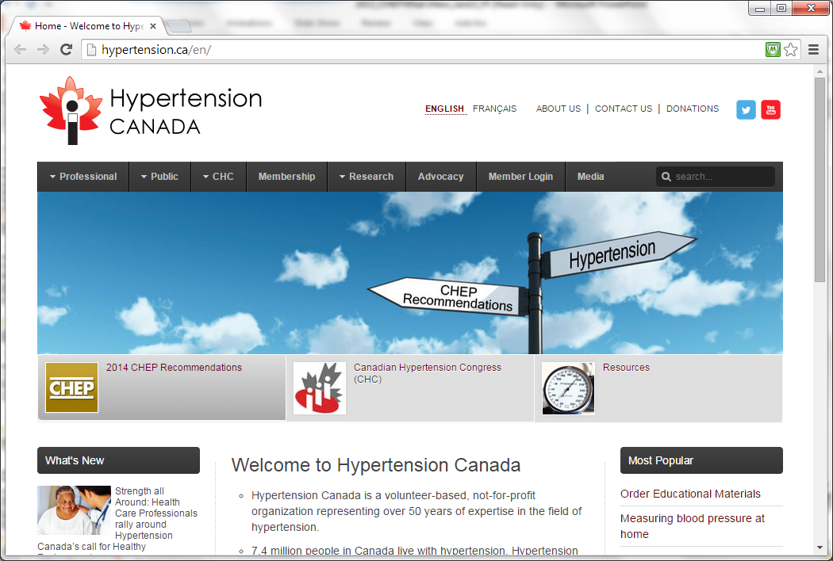
hypertension.ca
For patients:
  free access to the
  latest information
  and resources
For professionals:
  Access an accredited 15.5 hour interdisciplinary training program
  Sign up for free monthly news updates, featured research and educational resources
  Become a member for special privileges and savings
Notes:
Ask your patients to visit the public section of the website for free access to the latest information and resources.
Special efforts are being made for health care professionals to have greater accessibility to hypertension resources. Health care professionals can enroll at www.hypertension.ca to get automated email notices when new or updated hypertension resources are available for you and for your patients.
A case-based interactive lecture series on clinically important hypertension topics is available on the internet to provide additional learning opportunities, and for you to interact with national hypertension experts. The lecture series will feature important clinical topics provided by national experts, with case presentations and an opportunity to ask questions and make comments.
We will also continue and expand our programs to train community leaders in hypertension.

Slide 63
The 2016 CHEP Guidelines
What’s new in the treatment of hypertension?
What’s still really important?

Slide 64
Additional Data Slides

Slide 65
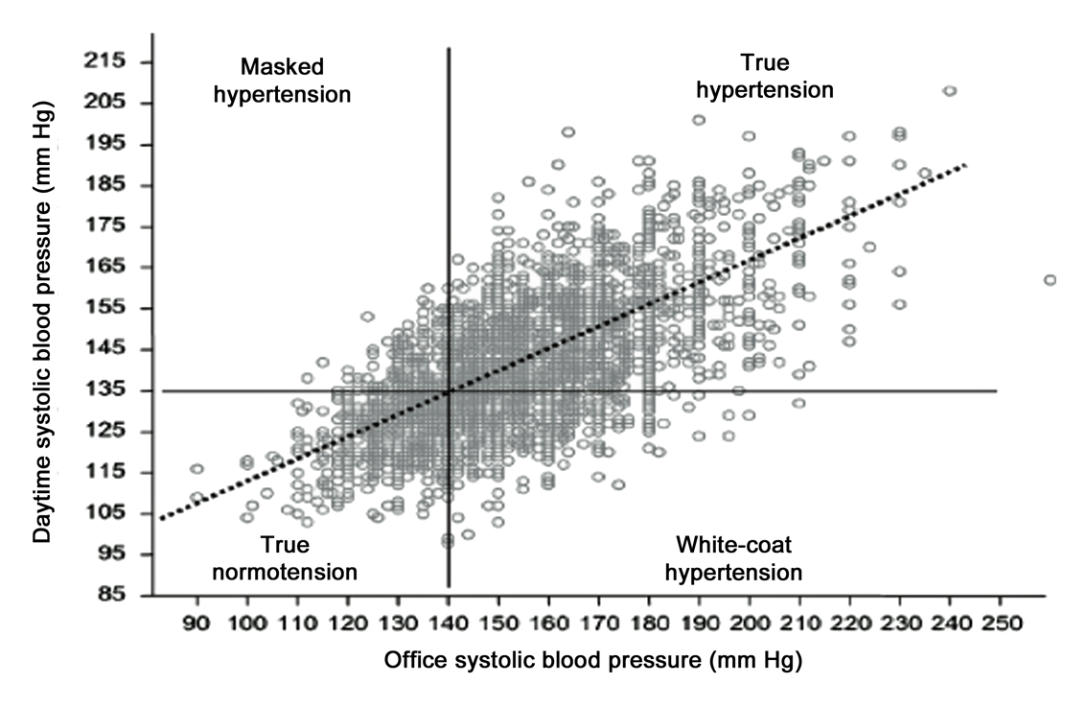
Office BP and ABPM: different evaluation of Blood Pressure
Verdecchia P et al, The clinical significance of white-coat and masked hypertension.
Blood Press Monit 2007; 12: 387–389
55
Notes:
3901 subjects, prevalence is 12-14% in a given family practice

Slide 66
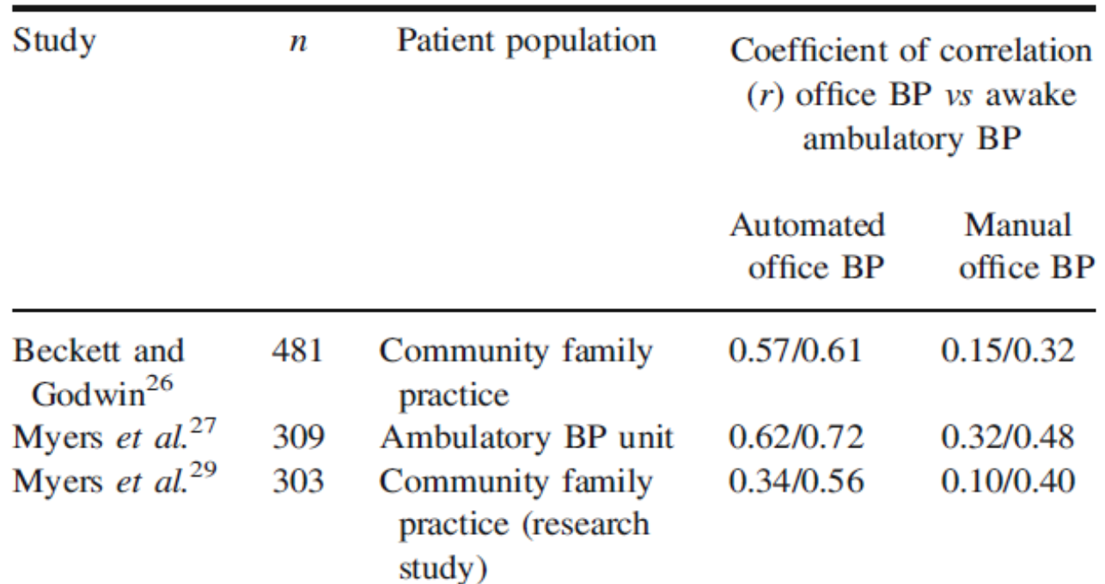
Correlation of AOBP and OBPM with ABPM
Stronger Correlation with ABPM for AOBP than for OBPM
Beckett L, Godwin M. BMC Cardiovasc Disord 2005;5:18;Myers MG, et al. J Hypertens 2009; 27: 280-6;
Myers MG, et al. BMJ 2011;342:d286

Slide 67
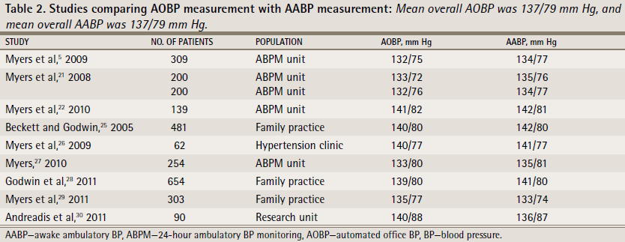
Studies comparing AOBP measurement with Awake ABPM
AOBPs Equivalent to Awake ABPs
Myers MG, et al. Can Fam Physician 2014;60:127-32; Myers MG. J Clin Hypertens 2014;16:83-6; Myers MG. J Hypertens 2012;30:1894-8; Myers MG, et al. Family Practice 2012;29:376-82; Myers MG, et al. BMJ 2011;342:d286; Myers MG. J Hypertens 2010;28:703-8; Myers MG, et al. J Hypertens 2009;27:280-6; Myers MG, et al. Blood Press Monit 2009;14:108-11; Myers MG, Godwin M. J Clin Hypertens 2007;9:267-70

