Slide 1
Hypertension 2017
Putting the Evidence into Practice

Slide 2
Disclosures
Relationships with commercial interests:
  Grants/Research Support:
  Speakers Bureau/Honoraria:
  Consulting Fees:
  Data Safety and Monitoring:

Slide 3
Disclosure of Commercial Support
This program has received financial support from Servier Canada in the form of an educational grant
This program has not received any in-kind support
Potential for conflict(s) of interest:
  _______has received an honoraria funding from Servier Canada, who has product(s) in this therapeutic area
Notes:
Servier products (Hypertension) include:
Coversyl (perindopril)
Coversyl Plus (perindopril + indapamide)
Lozide (indapamide)
Viacoram (perindopril + amlodipine)

Slide 4
Mitigating Potential Bias
The information presented is based on recent information that is explicitly ‘‘evidence-based’’ and
is solely based on Hypertension Canada Guidelines

Slide 5
Evidence-Based Annual Guidelines
Canada has the world’s highest reported national blood pressure control rates
Hypertension Canada is known as the most credible source for evidence-based hypertension guidelines, with annual updates, a well-validated review process and effective dissemination and implementation techniques across Canada
Notes:
Servier products (Hypertension) include:
Coversyl (perindopril)
Coversyl Plus (perindopril + indapamide)
Lozide (indapamide)
Viacoram (perindopril + amlodipine)

Slide 6
Learning Objectives
At the conclusion of this activity, participants will be able to:
Apply appropriate methods for making a diagnosis of hypertension
Implement evidence-based threshold and target BPs
Integrate new guidelines for hypertension management including:
  Use of longer-acting over shorter-acting diuretics
  Use of single pill combinations as a first-line treatment

Slide 7
Hypertension 2017
What’s new?
Longer acting (thiazide-like) diuretics are preferred
vs. shorter acting (thiazides)
Single pill combinations as a first line treatment (regardless of the extent of BP elevation)
Notes:
Hypertension Canada provides annually-updated, evidence-based guidelines for the diagnosis, assessment, prevention and treatment of hypertension. In 2017, 10 new recommendations were introduced, three previous recommendations have been revised, and five have been removed.
Among the new recommendations, two will be the focus of this educational program:
Longer acting (thiazide-like) diuretics are preferred vs. shorter acting (thiazides)
Single pill combinations as a first line treatment (regardless of the extent of BP elevation)
Reference
Leung AA, et al. Hypertension Canada’s 2017 Guidelines. Can J Cardiol. 2017.

Slide 8
Hypertension 2017
What’s still important?
The diagnosis of hypertension should be based
on out-of-office measurements; in the office,
use automated office BP monitoring (AOBP)
The threshold and target blood pressures are lower
in those at greater risk
Notes:
Among the previous Hypertension Canada 2016 guideline recommendations, two were thought to still be very important, and merit revisiting in this educational program:
The diagnosis of hypertension should be based on out-of-office measurements; in the office, use automated office BP monitoring (AOBP)
The threshold and target blood pressures are lower in those at greater risk
Examples of automated office BP measurement devices include:
BpTRU Vital Signs Monitor
Omron HEM-907
Microlife WatchBP Office
References
Leung A, et al. Hypertension Canada’s 2016 Canadian Hypertension Education Program Guidelines for Blood Pressure Measurement, Diagnosis, Assessment of Risk, Prevention, and Treatment of Hypertension. Can J Cardiol. 2016; 32: 569-588.
Leung AA, et al. Hypertension Canada’s 2017 Guidelines. Can J Cardiol. 2017.

Slide 9
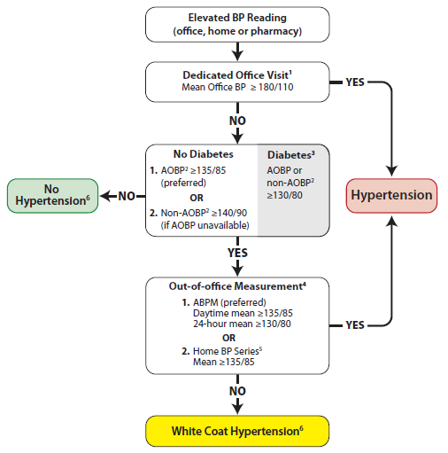
Hypertension Diagnostic Algorithm
Out of office assessment is the preferred means
of hypertension Dx
Measurement using electronic
(oscillometric) upper arm devices is preferred over auscultation
ABPM = ambulatory blood pressure measurement
AOBP = automated office blood pressure
Notes:
The hypertension algorithm shown on this slide is supplemented by the following notes:
If AOBP is used, use the mean calculated and displayed by the device. If non-AOBP (see note 2) is used, take at least three readings, discard the first and calculate the mean of the remaining measurements. A history and physical exam should be performed and diagnostic tests ordered.
AOBP = Automated Office BP. This is performed with the patient unattended in a private area.
Non-AOBP = Non-automated measurement performed using an electronic upper arm device with the provider in the room.
Diagnostic thresholds for AOBP, ABPM, and home BP in patients with diabetes have yet to be established (and may be lower than 130/80 mmHg).
Serial office measurements over 3-5 visits can be used if ABPM or home measurement not available.
Home BP Series: Two readings taken each morning and evening for 7 days (28 total). Discard first day readings and average the last 6 days.
Annual BP measurement is recommended to detect progression to hypertension.
References
Leung A, et al. Hypertension Canada’s 2016 Canadian Hypertension Education Program Guidelines for Blood Pressure Measurement, Diagnosis, Assessment of Risk, Prevention, and Treatment of Hypertension. Can J Cardiol. 2016; 32: 569-588.
Leung AA, et al. Hypertension Canada’s 2017 Guidelines. Can J Cardiol. 2017.

Slide 10
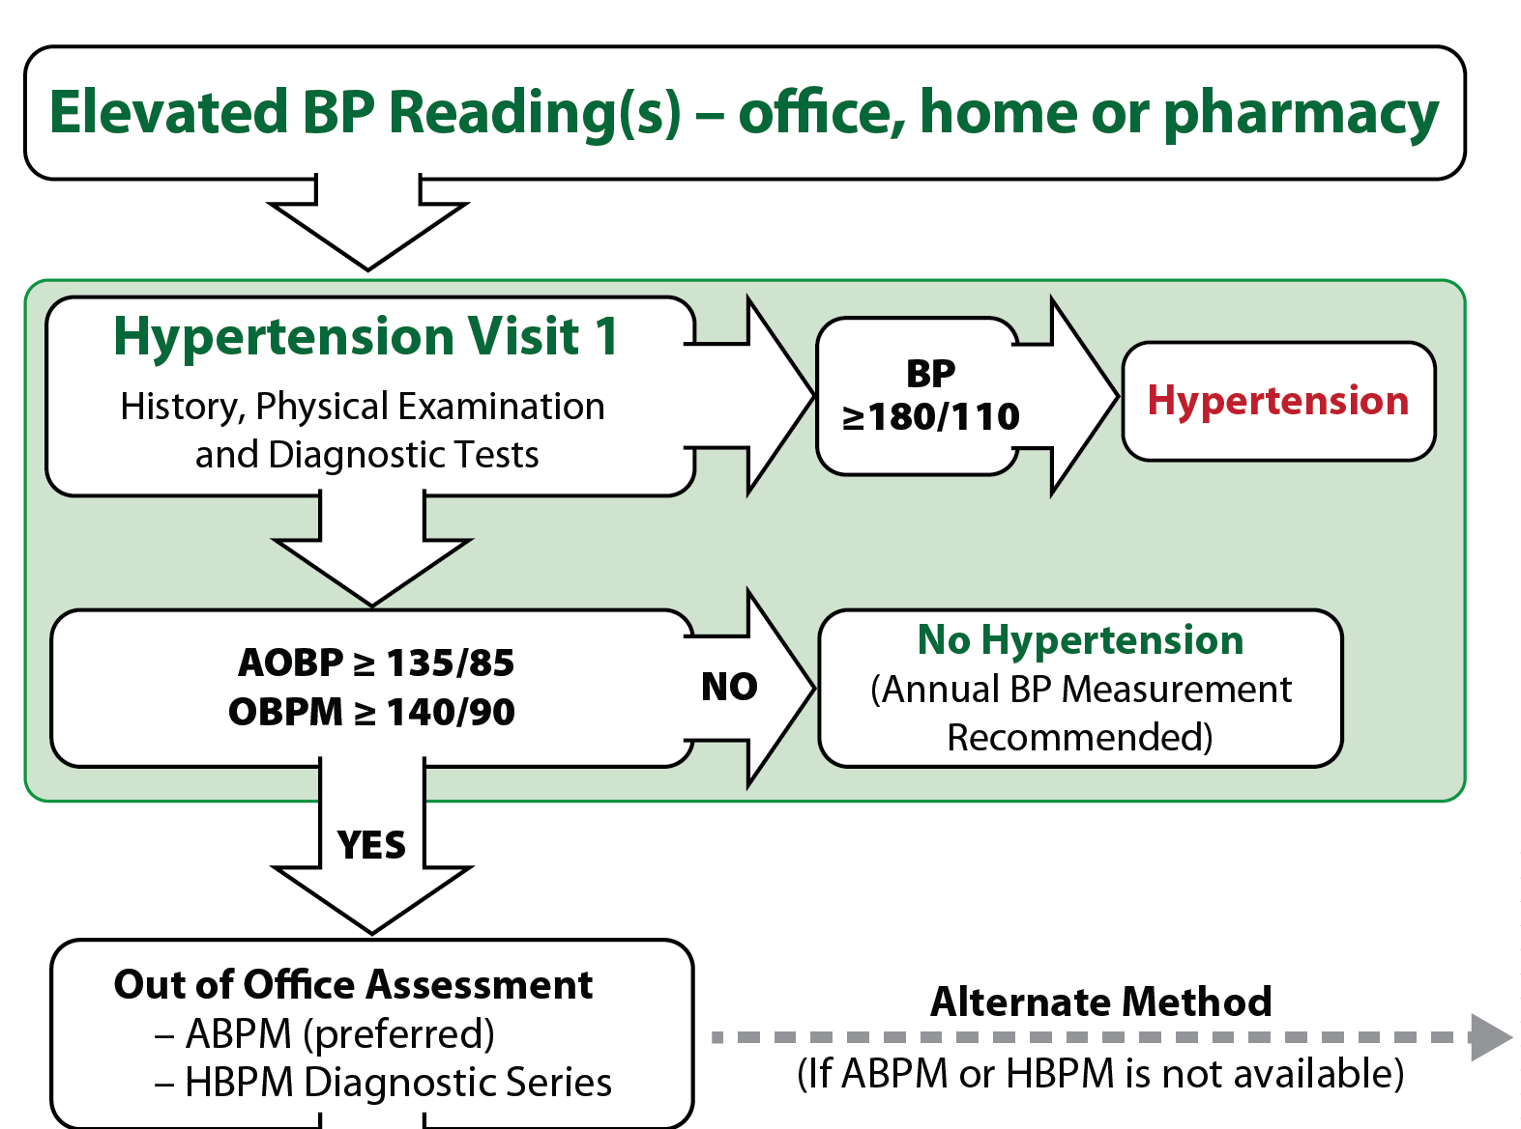
Out-of-Office Assessment is the
Preferred Means of Diagnosing Hypertension
Clinic BP as alternate method
AOBP = automated office blood pressure
OBPM = office BP measurement
ABPM = ambulatory BP measurement
HBPM = home BP measurement
Notes:
There is consistent evidence that blood pressure is not accurately assessed in routine practice. This is particularly true when BP is measured manually using an auscultatory technique and when standardized methodology is not followed.
Studies suggest that BP obtained in clinical practice is, on average, 9/6 mmHg higher than when standardized measurement tools are used. Inaccuracies in BP measurement can have clinical consequences such as misclassification of cardiovascular risk.
The Hypertension Canada Task Force strongly encourages the use of validated electronic digital oscillometric devices for accurate BP measurement. Furthermore, out-of-office BP measurement should be performed to confirm a diagnosis of hypertension (if possible).
References
Leung A, et al. Hypertension Canada’s 2016 Canadian Hypertension Education Program Guidelines for Blood Pressure Measurement, Diagnosis, Assessment of Risk, Prevention, and Treatment of Hypertension. Can J Cardiol. 2016; 32: 569-588.
Leung AA, et al. Hypertension Canada’s 2017 Guidelines. Can J Cardiol. 2017.

Slide 11
Out-of-Office BP Measurements
Out-of-office measurement identifies white coat hypertension and masked hypertension
ABPM has better predictive ability than OBPM and is the recommended out-of-office measurement method
HBPM has better predictive ability than OBPM and is recommended if ABPM is not tolerated, not readily available or due to patient preference
ABPM = ambulatory blood pressure measurement
HBPM = home BP measurement
OBPM = office BP measurement
Notes:
Masked hypertension describes the situation in which BP appears to be controlled when measured in the office but not at home. Therefore, relying on office-based BP measurement alone may result in missed cases of masked hypertension.
There are two options for out-of-office BP assessment: ambulatory 24-hour BP measurement and home BP measurement. 24-hour ABPM is the preferred out-of-office BP measurement modality because it assesses BP throughout the day and night. However, if ABPM is not available or if the patient is unable to tolerate it, HBPM is a suitable alternative.
References
Leung A, et al. Hypertension Canada’s 2016 Canadian Hypertension Education Program Guidelines for Blood Pressure Measurement, Diagnosis, Assessment of Risk, Prevention, and Treatment of Hypertension. Can J Cardiol. 2016; 32: 569-588.
Leung AA, et al. Hypertension Canada’s 2017 Guidelines. Can J Cardiol. 2017.

Slide 12
Out-of-Office BP Measurements are
More Highly Correlated With BP-Related Risk
LVH
Albumin excretion ratio
SBP
SBP
DBP
DBP
Indexes of hypertensive target organ damage
Indexes of hypertensive target organ damage
Mulè G, et al. J Cardiovasc Risk 2002;9:123-9.
Notes:
This study assessed the value of BP as a predictor of target organ damage in patients mild arterial hypertension.
The correlation between target organ damage, such as left ventricular hypertrophy (LVH), and albumin excretion ratio was weaker with office BP (OBP) and stronger with ambulatory BP measurement (ABPM).
Moreover, the correlation with self (home) BP was higher than with OBP, but less than with ABPM, for both systolic and diastolic BP.
Reference
Mulè G, et al. Value of home pressures as predictor of target organ damage in mild arterial hypertension. J Cardiovasc Risk. 2002;9:123-9.

Slide 13
White Coat and Masked Hypertension
Derived from Pickering TG, et al. Hypertension 2002:40:795-6.
200
180
MASKED
HYPERTENSION
TRUE
HYPERTENSION
160
Ambulatory BP mmHg
140
135
WHITE COAT
HYPERTENSION
120
NORMOTENSION
100
100
120
140
160
180
200
Manual Office BP mmHg
Derived from Pickering TG, et al. Hypertension 2002:40:795-6.
Notes:
The addition of ABPM to conventional OBPM for defining BP status in clinical practice has added a layer of complexity to the process because the separation of normotension and hypertension can be assessed independently by each of the two methods. Only relying on OBPM risks missing cases of white coat or masked hypertension.¹
This slide depicts the four potential groups of patients who are:²
Normotensive by both methods (true normotensives)
Hypertensive by both methods (true or sustained hypertensives)
Hypertensive by OBPM and normotensive by ABPM (white coat hypertensives)
Normotensive by OBPM and hypertensive by ABPM (masked hypertensives)
From a clinical perspective, the first two groups are simple because both methods give the same classification. The last two groups are more complex because there is disagreement between the methods. Their distinction is important because white coat hypertensives are generally at low relative risk of CV morbidity, whereas masked hypertensives show more extensive target organ damage than true normotensives.²
References
Hypertension Canada. The 2015 Canadian Hypertension Education Program recommendations (2015 annual update). Available at www.hypertension.ca.
Pickering TG, et al. Masked hypertension. Hypertension 2002;40:795-6.

Slide 14
Criteria for the Diagnosis of Masked Hypertension
 | BP (mm Hg)
Office BP Automated office BP | < 140/90 < 135/85
Awake Ambulatory | ≥ 135/85
24-hour Ambulatory BP | ≥ 130/80
Notes:
The term ‘masked hypertension’ is defined as having non-elevated clinical (office) BP with elevated out-of-clinic average BP, typically determined by ambulatory BP monitoring.¹
A diagnosis of masked hypertension is defined by non-elevated office BP <140/90 mmHg or <135/85 mmHg using automated devices,² and the most widely used definition for elevated awake ambulatory BP is ≥135/85 mmHg.^{2,3,4}
References
Pickering TG et al. Masked hypertension. Hypertension. 2002; 49)6):795-6.
Canadian Hypertension Education Program (CHEP). The 2015 CHEP recommendations. Available at www.hypertension.ca/en/chep.
O’Brien E et al. Practice guidelines of the European Society of Hypertension for clinic, ambulatory and self blood pressure measurement. J Hypertens. 2005; 23(4):697.
Peacock J et al. Unmasking masked hypertension: prevalence, clinical implications, diagnosis, correlates and future directions. J Hum Hypertens. 2014; 28:521-8

Slide 15


Prevalence of Masked Hypertension
about
about
higher
10%
30%
in patients with
in the general population
in treated hypertensive
patients
diabetes
and
chronic kidney
disease patients
One out of three treated hypertensive patients
has masked hypertension
Andalib A, et al. Int Med J 2012;42:260-6
Notes:
The estimated prevalence of masked hypertension (MH) as reported in prospective cohort studies varies. In the general population, the prevalence of MH is ~10% whereas the prevalence is higher in populations of treated hypertensive patients, reaching ~30%.¹ The prevalence of MH is higher in patients with comorbidities including those with diabetes (up to 42.5%)² and kidney disease (up to 32%).³
National and international registries suggest that when looking for MH within office-controlled patients, up to one in three could have MH.⁴
References
Peacock J et al. Unmasking masked hypertension: prevalence, clinical implications, diagnosis, correlates and future directions. J Hum Hypertens. 2014; 28:521-8.
Franklin SS et al. Masked hypertension in diabetes mellitus: treatment implications for clinical practice. Hypertension. 2013; 61(5):964-71.
Gorostidi M et al. Differences between office and 24-hour blood pressure control in hypertensive patients with CKD: A 5,693-patient cross-sectional analysis from Spain. Am J Kidney Dis. 2013; 62(2):285-94.
Gorostidi M et al. Prevalence of white-coat and masked hypertension in national and international registries. Hypertens Res. 2015; 38:1-7.

Slide 16
The Prognosis of White Coat and Masked Hypertension
35
CV Events
30
25
20
CV events per 1000 patient-year
15
10
5
0
Normal
White coat
Uncontrolled
Masked
Okhubo T, et al. J Am Coll Cardiol 2005;46;508-15
Notes:
This study evaluated 24-hour ABPM and in-office BP values obtained from 1,332 Japanese subjects who were followed for a mean of 10.2 years.
The risk of CV events (CV mortality and stroke morbidity) in subjects with masked hypertension or uncontrolled hypertension was significantly higher than for subjects with normal BP or white coat hypertension.
This pattern was observed across subgroups including men vs. women, treated vs. untreated hypertension, and high- vs. low-CV risk groups.
This study provides evidence that white coat hypertension is associated with a more benign outcome than sustained hypertension over a period of 10 years, and in fact approximates outcomes of subjects with normotension. It also supports the observation that masked hypertension is a strong predictor of CV risk.
Reference
Okhubo T, et al. Prognosis of « masked » hypertension and « white coat » hypertension detected by 24-h ambulatory blood pressure monitoring 10-year follow-up from the Ohasama study. J Am Coll Cardiol. 2005;46;508-15.

Slide 17

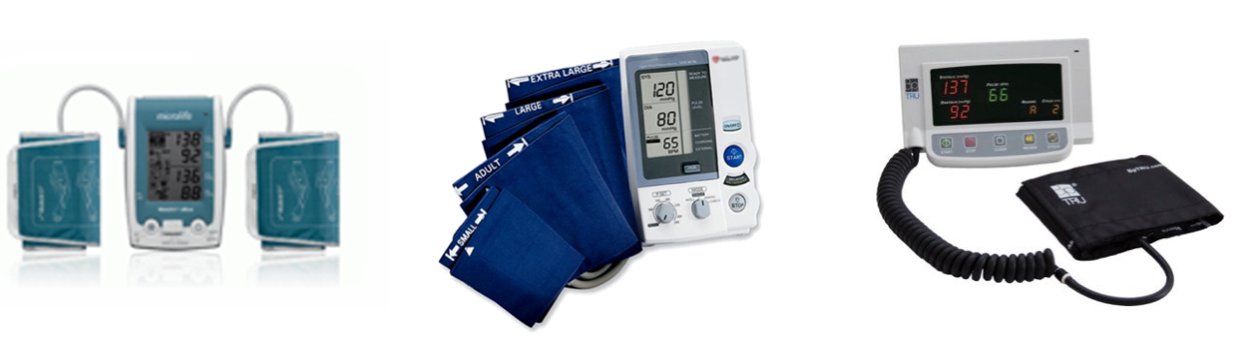
Automated Office BP Measurement Preferred
Automated office blood pressure (AOBP) is the preferred method of performing in-office BP measurement
Automated Office (unattended, AOBP)
Oscillometric (electronic)
Notes:
In 2016, the Hypertension Canada guidelines made a new recommendation regarding the preferred use of automated devices for in-office BP measurement (Grade D recommendation).
AOBP uses fully automated electronic oscillometric devices without any patient-provider interaction; it is designed to be used while the patient rests alone in a quiet room or private area.
References
Leung A, et al. Hypertension Canada’s 2016 Canadian Hypertension Education Program Guidelines for Blood Pressure Measurement, Diagnosis, Assessment of Risk, Prevention, and Treatment of Hypertension. Can J Cardiol. 2016; 32: 569-588.
Leung AA, et al. Hypertension Canada’s 2017 Guidelines. Can J Cardiol. 2017.

Slide 18
Automated Office BP Measurement
More closely approximates ABPM than routine office BPs (mitigates white coat effect)¹⁻³
Is more predictive of end organ damage
(LVMI, proteinuria and cIMT), similar to ABPM⁴⁻⁶
ABPM = ambulatory blood pressure measurement
LVMI = left ventricular mass index
cIMT = carotid intima media thickness
Beckett L, et al. BMC Cardiovasc Disord 2005;5:18; 2. Myers MG, et al. J Hypertens 2009;27:280-6;
3. Myers MG, et al. BMJ 2011;342;d286;4. Campbell NRC, et al. J Hum Hypertens 2007;21:588-90;
5. Andreadis EA, et al. Am J Hypertens 2011;24:661-6; 6. Andreadis EA, et al. Am J Hypertens 2012;25:969-73.
Notes:
There are several other advantages of AOBP over manual approaches including:
Eliminates the risk of conversation during readings
Facilitates multiple measurements with each clinical encounter
Automatically calculates a mean BP
Demonstrated consistency of measurements from visit to visit
Eliminates the need for the health care provider to perform sequential electronic measurements
References
Leung A, et al. Hypertension Canada’s 2016 Canadian Hypertension Education Program Guidelines for Blood Pressure Measurement, Diagnosis, Assessment of Risk, Prevention, and Treatment of Hypertension. Can J Cardiol. 2016; 32: 569-588.
Leung AA, et al. Hypertension Canada’s 2017 Guidelines. Can J Cardiol. 2017.

Slide 19
AOBP Readings are Lower than OBP Readings and are More Similar to ABP Readings
 | Mean blood pressure* (mmHg)
 | Centre for Studies in Primary Care₁ | ABPM referral unit₂ | CAMBO trial₃
Routine manual office BP | 151/83 | 152/87 | 150/81
Automated office BP | 140/80 | 132/75 | 135/77
Awake ambulatory BP | 142/80 | 134/77 | 133/74
*The automated office blood pressure (BP) and awake ambulatory BP were similar,
and both were lower than the routine manual BP obtained in community practice.
1. Beckett L et al , BMC Cardiovasc. Disord. 2005; 5: 18. 2. Myers MG et al, J. Hypertens. 2009; 27: 280. 3. Myers MG, et al. BMJ 2011; 342: d286.
Notes:
Studies have shown that across clinical settings, AOBP measurements are consistently lower than in-office BP readings and more closely approximate awake ambulatory BP readings.¹⁻³ In other words, AOBP significantly reduces the white coat effect compared to manual BP measurement.
These observations are important when considering the application of the SPRINT BP thresholds to routine clinical practice. Given the consistently lower BP readings using AOBP compared with manual in-office techniques, it is important that the SPRINT thresholds be applied in the same context as the clinical trial, i.e. with the use of AOBP measurements, and not in-office manual readings.
It has been suggested that if standard in-office BP measurement is used without a resting period and without automated oscillometric measurements while personnel are not in the room (i.e. not following the SPRINT protocol for AOBP), the goal SBP ranges should be adjusted to 5-10 mmHg higher than in the trial.⁴
References
Beckett L, et al. The BpTRU automatic blood pressure monitor compared to 24 hour ambulatory blood pressure monitoring in the assessment of blood pressure in patients with hypertension. BMC Cardiovasc Disord. 2005; 5: 18.
Myers MG, et al. Use of automated office blood pressure measurement to reduce the white coat response. J Hypertens. 2009; 27: 280-286.
Myers MG, et al. Conventional versus automated measurement of blood pressure in primary care patients with systolic hypertension: randomised parallel design controlled trial. BMJ. 2011; 342: d286.
Bakris GL. The implications of blood pressure measurement methods on treatment targets for blood pressure. Circulation. 2016; 134: 904-905.

Slide 20
Hypertension 2017
What’s still important?
The diagnosis of hypertension should be based
on out-of-office measurements; in the office,
use automatic office BP monitoring (AOBP)
The threshold and target blood pressures are lower
in those at greater risk

Slide 21
Usual Office BP Threshold Values for
Initiation of Pharmacological Treatment
Population | SBP | DBP
High Risk (SPRINT population) # | ≥130 | NA
Diabetes | ≥ 130 | ≥ 80
Moderate* | ≥ 140 | ≥ 90
Low risk (no TOD or CV risk factors) | ≥ 160 | ≥ 100
AOBP = automated office blood pressure
TOD = target organ damage
SBP = systolic blood pressure
DBP = diastolic blood pressure
# Based on AOBP
*AOBP threshold ≥ 135/85 mmHg
Notes:
This slide shows the Hypertension Canada thresholds for initiating antihypertensive treatment. In 2016, a row was added for high-risk patients based on the SPRINT study findings, which will be detailed in the subsequent slides. Moderate risk represents a risk of up to 15%.
References
Leung A, et al. Hypertension Canada’s 2016 Canadian Hypertension Education Program Guidelines for Blood Pressure Measurement, Diagnosis, Assessment of Risk, Prevention, and Treatment of Hypertension. Can J Cardiol. 2016; 32: 569-588.
Leung AA, et al. Hypertension Canada’s 2017 Guidelines. Can J Cardiol. 2017.

Slide 22
Recommended Office BP Treatment Targets
Treatment consists of health behaviour ± pharmacological management
Population | SBP | DBP
High Risk # | < 120 | NA
Diabetes | < 130 | < 80
All others* | < 140 | < 90
# Based on AOBP
*AOBP threshold ≥ 135/85 mmHg
Notes:
This slide shows the Hypertension Canada BP treatment targets based on the presence (or not) of additional risk factors.
The lower treatment target for selected patients at high CV risk reflects current evidence notably from the SPRINT trial. This threshold can be considered for patients at high CV risk but without diabetes or previous stroke.
References
Leung A, et al. Hypertension Canada’s 2016 Canadian Hypertension Education Program Guidelines for Blood Pressure Measurement, Diagnosis, Assessment of Risk, Prevention, and Treatment of Hypertension. Can J Cardiol. 2016; 32: 569-588.
Leung AA, et al. Hypertension Canada’s 2017 Guidelines. Can J Cardiol. 2017.

Slide 23
New Guideline Post-SPRINT
For high-risk patients, aged ≥ 50 years, with systolic BP levels ≥130 mm Hg, intensive management to target a systolic BP ≤120 mm Hg should be considered
Intensive management should be guided by automated office BP measurements
Patient selection for intensive management is recommended and caution should be taken in certain
high-risk groups
Notes:
These recommendations by Hypertension Canada were established in 2016 and were largely the result of the SPRINT study findings.
SPRINT was a randomized controlled trial that randomized 9631 subjects at high risk for CVD (but without diabetes or prior stroke) to a SBP target of <120 mmHg or standard SBP target of <140 mmHg as assessed using AOBP. The trial was stopped early (i.e. after 3.2 years of the planned 5 years of follow-up) after an interim analysis found a significant reduction in CV events with intensive treatment.
The SPRINT results are consistent with two meta-analyses that reported a strong linear association between lower SBP targets and fewer major adverse CV events. These meta-analyses provide additional support for Hypertension Canada’s 2016 recommendation for lower SBP targets in selected high-risk patients.
References
Leung A, et al. Hypertension Canada’s 2016 Canadian Hypertension Education Program Guidelines for Blood Pressure Measurement, Diagnosis, Assessment of Risk, Prevention, and Treatment of Hypertension. Can J Cardiol. 2016; 32: 569-588.
Leung AA, et al. Hypertension Canada’s 2017 Guidelines. Can J Cardiol. 2017.

Slide 24
SPRINT: SBPs Achieved
Average no. of medications
Intensive care: 2.8
Standard care: 1.8
The SPRINT Research Group, NEJM, Nov 9th, 2015
Notes:
In SPRINT, both the standard and intensive treatment strategies rapidly and significantly reduced SBP. At 1 year, the mean SBP values were 121.4 mmHg and 136.2 mmHg for the intensive and standard arms, respectively. This difference of ~15 mmHg was maintained over time.
These SBP reductions were obtained using an average of 2.8 and 1.8 antihypertensive medications, respectively. The number of medications used in each group was largely stable from year 1 onwards. The relative distribution of the antihypertensive medication classes was largely similar between the two treatment arms.
Reference
SPRINT Research Group. A randomized trial of intensive versus standard blood-pressure control. N Engl J Med. 2015; 373: 2103-2116.

Slide 25
SPRINT Primary Outcome
NNT=61
The SPRINT Research Group, NEJM, Nov 9th, 2015
Notes:
The primary endpoint in the SPRINT trial was a composite outcome of myocardial infarction, acute coronary syndrome not resulting in myocardial infarction, stroke, acute decompensated heart failure, or death from CV causes.
A primary outcome event occurred in 243 subjects (1.65%/yr) in the intensive treatment group compared to 319 subjects (2.19%/yr) in the standard treatment group, for a highly statistically significant 25% relative risk reduction (P<0.001) with intensive treatment, with the two curves beginning to separate by 1 year.
The benefits of intensive treatment were consistent across all of the individual components of the primary composite outcome measure, as well as other pre-specified secondary endpoints.
Reference
SPRINT Research Group. A randomized trial of intensive versus standard blood-pressure control. N Engl J Med. 2015; 373: 2103-2116.

Slide 26
New Thresholds/Targets for the High-Risk Patient
Post-SPRINT: Who does this apply to?
Clinical or sub-clinical cardiovascular disease
OR
Chronic kidney disease (non-diabetic nephropathy, proteinuria <1 g/d, *estimated glomerular filtration rate 20-59 mL/min/1.73m²)
OR
†Estimated 10-year global cardiovascular risk ≥15%
OR
Age ≥ 75 years
There was an increased risk of renal deterioration, potassium abnormalities and hypotension with intensified therapy
Patients with one or more clinical indications should consent to intensive management
* Four variable MDRD equation
† Framingham Risk Score, D'Agastino, Circulation 2008
Notes:
The high-risk criteria listed on this slide are reflective of the inclusion criteria for the SPRINT trial. It should be noted that the benefits of lower BP targets in high-risk individuals were offset by an increased risk of renal deterioration in patients with normal kidney function, more frequent electrolyte abnormalities, and higher incidence of hypotension.
Evidence supporting lower SBP targets in high-risk individuals remains limited, making intensive SBP-lowering more difficult to justify and underscoring the importance of obtaining informed consent from patients.
References
Leung A, et al. Hypertension Canada’s 2016 Canadian Hypertension Education Program Guidelines for Blood Pressure Measurement, Diagnosis, Assessment of Risk, Prevention, and Treatment of Hypertension. Can J Cardiol. 2016; 32: 569-588.
Leung AA, et al. Hypertension Canada’s 2017 Guidelines. Can J Cardiol. 2017.

Slide 27
New Thresholds/Targets for the High-Risk Patient
Post-SPRINT: Who does this NOT apply to?
Limited or No Evidence:
Heart failure (EF <35%) or recent MI (within last 3 months)
Indication for, but not currently receiving, a beta-blocker
Institutionalized elderly
Inconclusive Evidence:
Diabetes mellitus
Prior stroke
eGFR < 20 ml/min/1.73m²
Contraindications:
Patient unwilling or unable to adhere to multiple medications
Standing SBP <110 mmHg
Inability to measure SBP accurately
Known secondary cause(s) of hypertension
Notes:
Risks and benefits of intensified treatment should be carefully weighed since patients are at risk for both adverse vascular events and also adverse treatment effects (i.e. side effects).
Serious adverse events occurred in 38.3% of subjects in the intensive treatment arm and 37.1% of the standard treatment arm (HR 1.04; P=0.25). There were significantly more serious adverse events of hypotension, syncope, electrolyte abnormalities, and acute kidney injury or acute renal failure, but not injuries due to falls, or bradycardia, in the intensive treatment arm.
These potential risks should be considered in the context of the potential benefits of achieving lower SBP targets including significantly lower rates of fatal and nonfatal major cardiovascular events and death from any cause.
References
Leung A, et al. Hypertension Canada’s 2016 Canadian Hypertension Education Program Guidelines for Blood Pressure Measurement, Diagnosis, Assessment of Risk, Prevention, and Treatment of Hypertension. Can J Cardiol. 2016; 32: 569-588.
SPRINT Research Group. A randomized trial of intensive versus standard blood-pressure control. N Engl J Med. 2015; 373: 2103-2116.

Slide 28
Hypertension 2017
What’s new?
Longer acting (thiazide-like) diuretics are preferred
vs. shorter acting (thiazides)
Single pill combinations should be used as a first line treatment (regardless of the extent of BP elevation)

Slide 29
Longer-acting Diuretics Should be Preferred
(i.e., thiazide-like are preferred to thiazides)
Longer-acting (thiazide-like): chlorthalidone, indapamide
Shorter-acting (thiazides): hydrochlorothiazide
Notes:
New in 2017, the Hypertension Canada guidelines state a preference for longer-acting diuretics (i.e. thiazide-like) such as chlorthalidone and indapamide over shorter-acting diuretics (i.e. thiazides) such as hydrochlorothiazide (Grade B).
Reference
Leung AA, et al. Hypertension Canada’s 2017 Guidelines. Can J Cardiol. 2017.

Slide 30
Thiazide-type vs. Thiazide-like Diuretics:
CV Events and Mortality Meta-analysis
Design: Meta-analysis of 21 RCTs of BP lowering comparing thiazide-type
or thiazide-like diuretics vs. placebo or another antihypertensive on
CV events and mortality
>500,000 person-years of observation combined
Thiazide-type:
  Hydrochlorothiazide
  Bendrofluazide
  Chlorothiazide
Thiazide-like:
  Indapamide
  Chlorthalidone
Olde Engberink RH. Hypertension 2015;65(5):1033-40
Notes:
The Hypertension Canada 2017 recommendation for use of longer-acting diuretics over shorter-acting diuretics is based in part of this meta-analysis of 21 RCTs.
Thiazide-like diuretics have longer elimination half-life than thiazide diuretics, and this may have differential effects on CV risk. This meta-analysis included 21 placebo- or active-controlled RCTs including 25 comparisons and >480,000 patient-years of follow-up. Outcomes were not affected by heterogeneity in age, sex, or ethnicity, and there was no evidence of publication bias.
Reference
Olde Engberink RH, et al. Effects of thiazide-type and thiazide-like diuretics on cardiovascular events and mortality: systematic review and meta-analysis. Hypertension. 2015; 65: 1033-1040.

Slide 31
Diuretic Type Meta-Analysis vs. Placebo
Both types of diuretics reduced CV events, cerebrovascular events, and HF
Only thiazide-like diuretics additionally reduced coronary
events and all-cause mortality
Event | Thiazide-Type | Thiazide-Like
CV | 0.67 (.56-.81) | 0.67 (0.60-0.75)
Coronary | 0.81 (0.63-1.05) | 0.76 (0.61-0.96)
Cerebrovascular | 0.52 (0.38-0.69) | 0.68 (0.57-0.80)
Heart Failure | 0.36 (0.16-0.84) | 0.47 (0.36-0.61)
All-cause Mortality | 0.86 (0.75-1.00) | 0.84 (0.74-0.96)
Olde Engberink RH. Hypertension 2015;65(5):1033-40
Notes:
Thiazide-like diuretics have longer elimination half-life than thiazide diuretics, and this may have differential effects on CV risk. This meta-analysis included 21 placebo- or active-controlled RCTs including 25 comparisons and >480,000 patient-years of follow-up. Outcomes were not affected by heterogeneity in age, sex, or ethnicity, and there was no evidence of publication bias.
Both thiazide-like and thiazide diuretics were associated with significant reductions in CV events, cerebrovascular events, and heart failure. However, only thiazide-like diuretics were associated with significant benefits in terms of coronary disease and all-cause mortality.
Meta-regression showed an additional 12% risk reduction for CV events (p=0.049) and 21% risk reduction for heart failure (p=0.023) for thiazide-like vs. thiazide diuretics after adjusting for differences in BP reduction.
Both types of diuretics had similar tolerability profiles.
Reference
Olde Engberink RH, et al. Effects of thiazide-type and thiazide-like diuretics on cardiovascular events and mortality: systematic review and meta-analysis. Hypertension. 2015; 65: 1033-1040.

Slide 32
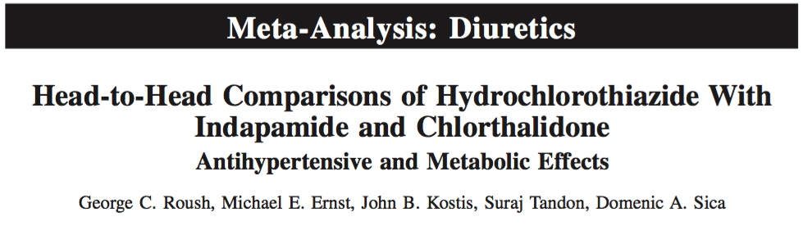
Design: Meta-analysis of 14 RCTs (n=883) comparing HCTZ vs. indapamide/chlorthalidone on BP reduction
  Compared according to 3 different dose levels: HCTZ 12.5, 25, 50 mg;
  chlorthalidone 6.25, 12.5, 25 mg; indapamide 1.5, 2, 2.5 mg
SBP reduction:
  Indapamide vs. HCTZ: −5.1 mmHg (p=0.004)
  Chlorthalidone vs. HCTZ: −3.6 mmHg (p=0.052)
Metabolic effects:
  No differences between HCTZ vs. indapamide in adverse effects (K+, Na+, Cr, BG, cholesterol, uric acid); no data for HCTZ vs. chlorthalidone
Roush GC, et al. Hypertension. 2015 May;65(5):1041-6
Notes:
A second meta-analysis supports Hypertension Canada’s new recommendation for preference of thiazide-like diuretics over thiazide diuretics.
This meta-analysis included 14 head-to-head RCTs comparing hydrochlorothiazide versus indapamide and chlorthalidone in 883 subjects. The outcomes of interest were antihypertensive potency and metabolic effects.
For each comparison, there was minimal heterogeneity across trials and no evidence of publication bias.
Reference
Roush GC, et al. Head-to-head comparisons of hydrochlorothiazide with indapamide and chlorthalidone: antihypertensive and metabolic effects. Hypertension. 2015; 65: 1041-1046.

Slide 33
Head-to-Head for BP Lowering:
HCTZ vs. Chlorthalidone or Indapamide
Meta-analysis
Used 3 dose levels to try to standardize dosing
  Hydrochlorothiazide (12.5/25/50 mg)
  Chlorthalidone (6.25/12.5/25 mg)
  Indapamide (1.5/2.0/2.5 mg)
  Outcomes:
    BP lowering
    Metabolic
    CV events
Roush GC et al. Hypertension 2015;65:1041-6
Notes:
The dose of diuretic in each arm was assigned to one of three levels to make fair comparisons between drugs. Each of the 14 RCTs included in the meta-analysis was thus classified by a relative dose level (HCTZ higher than INDAP or CTDN; INDAP higher than HCTZ; or CTDN higher than HCTZ), and dose equivalent (i.e. drugs given at the same dose in both arms).
The main outcomes of interest were BP reduction, metabolic effects (e.g. serum potassium, serum sodium, creatinine, glucose, cholesterol and uric acid), and CV events (e.g. stroke).
Reference
Roush GC, et al. Head-to-head comparisons of hydrochlorothiazide with indapamide and chlorthalidone: antihypertensive and metabolic effects. Hypertension. 2015; 65: 1041-1046.

Slide 34
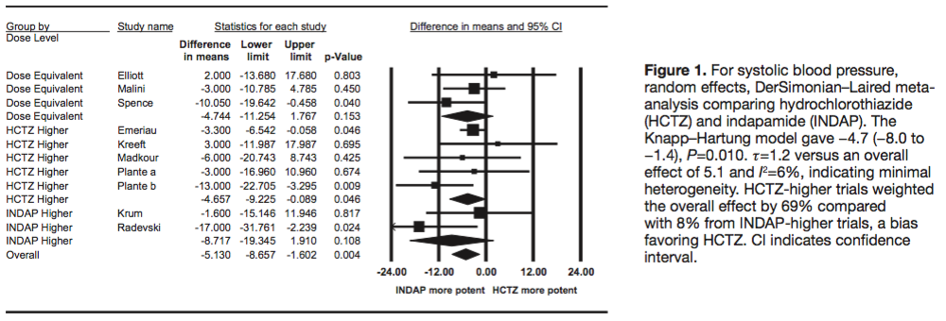
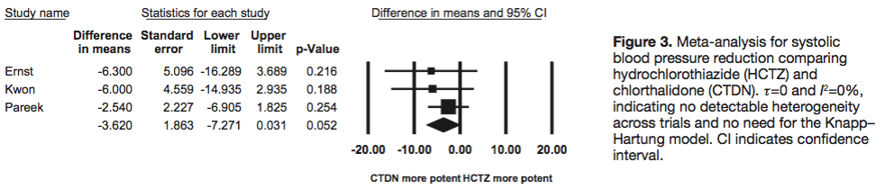
For BP Lowering,
Hydrochlorothiazide is LESS Effective than Indapamide or Chlorthalidone
Indapamide more effective than HCTZ (p=0.004)
Chlorthalidone more effective than HCTZ (p=0.052)
Roush GC et al. Hypertension 2015;65:1041-6
Notes:
In the comparison of SBP reduction, indapamide produced a statistically significantly greater reduction than HCTZ (−5.1 mmHg; p=0.004) with minimal heterogeneity across 10 trials.
Similarly, chlorthalidone produced a greater SBP reduction vs. HCTZ that approached statistical significance (−3.6 mmHg; p=0.052), with no evidence for publication bias.
Reference
Roush GC, et al. Head-to-head comparisons of hydrochlorothiazide with indapamide and chlorthalidone: antihypertensive and metabolic effects. Hypertension. 2015; 65: 1041-1046.

Slide 35
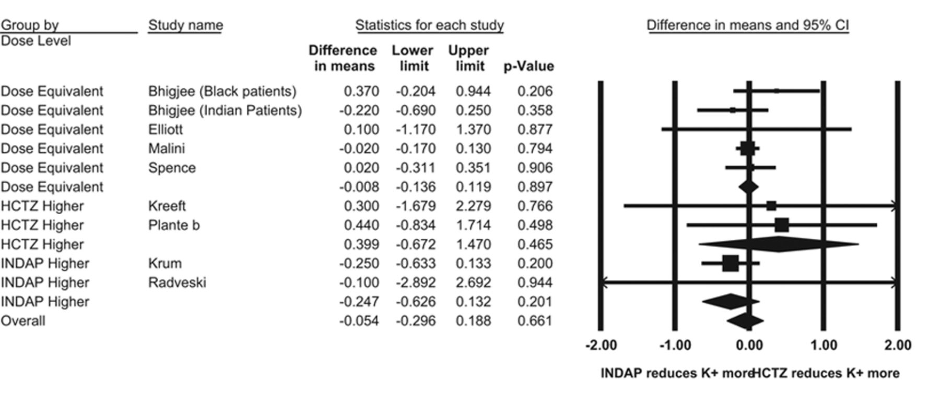
Indapamide and Hydrochorothiazide have Similar Effects on Serum Potassium Levels
Roush et al. Hypertension. 2015;65:1041-1046
Notes:
There were no detectable differences between indapamide and HCTZ on serum potassium (as shown on this Forest plot), or for other metabolic effects (data not shown).
For the effects on serum potassium in mEq/L, random effects, DerSimonian–Laired meta-analysis comparing hydrochlorothiazide (HCTZ) and indapamide (INDAP). There was no heterogeneity across trials. HCTZ-higher trials weighted the overall effect by 1% compared with 10% from INDAP-higher trials, indicating a slight bias toward INDAP causing a greater hypokalemic effect. CI indicates confidence interval.
Reference
Roush GC, et al. Head-to-head comparisons of hydrochlorothiazide with indapamide and chlorthalidone: antihypertensive and metabolic effects. Hypertension. 2015; 65: 1041-1046.

Slide 36
Chlorthalidone vs. Hydrochlorothiazide for BP Lowering (Ambulatory BP Measurement)
Design: 12-week RCT (double-blind)
Population: stage 1 hypertension (140 -159/ 90-99 mmHg), India (n=54)
Intervention: chlorthalidone 6.25 vs. HCTZ 12.5 vs. HCTZ (controlled release) 12.5 mg
1°outcomes: 24h ABPM baseline to weeks 4 & 12
  ↓ SBP & DBP with chlorthalidone and HCTZ-CR (p<0.01),
  but not conventional HCTZ
Pareek AK, et al. J Am Coll Cardiol 2016;67(4):379-89
Notes:
The Hypertension Canada recommendation for a preference for thiazide-like over thiazide diuretics is also supported by this 12-week RCT in 54 subjects with stage 1 hypertension in India. Subjects were randomized to low-dose chlorthalidone (6.25 mg daily; n=16), HCTZ (12.5 mg daily; n=18) or controlled release HCTZ (12.5 mg daily; n=20).
ABPM was performed at baseline, 4 weeks, and 12 weeks.
Reference
Pareek AK, et al. Efficacy of low-dose chlorthalidone and hydrochlorothiazide as assessed by 24-h ambulatory blood pressure monitoring. J Am Coll Cardiol. 2016; 67: 379-389.

Slide 37
Chlorthalidone More Effective Than Hydrochlorothiazide in BP Reduction
Ambulatory SBP
Ambulatory DBP
Mean change from baseline
at week 12
P=0.007
P<0.001
Kruskal-Wallis test used with Dunn’s test for multiple comparisons; comparison between baseline and Wilcoxon signed rank test results. Mean 24h SBP was significantly lower for the chlorthalidone group than for the HCTZ group at week 4 (125.52 vs. 139.71 mmHg, respectively, P=0.019) and week 12 (121.87 vs. 136.64 mmHg, respectively, P=0.013). Intent-to-treat population.
Pareek AK, et al. J Am Coll Cardiol 2016;67(4):379-89
Notes:
Treatment with low-dose chlorthalidone (6.25 mg daily) significantly reduced mean 24-h ABP as well as daytime and nighttime BP compared to HCTZ (12.5 mg daily).
Due to its short duration of action, no significant 24-h ABP reduction was seen with HCTZ (12.5 mg daily), which merely converted sustained hypertension into masked hypertension.
Reference
Pareek AK, et al. Efficacy of low-dose chlorthalidone and hydrochlorothiazide as assessed by 24-h ambulatory blood pressure monitoring. J Am Coll Cardiol. 2016; 67: 379-389.

Slide 38
Summary:
Longer-Acting Diuretics Preferred
Longer-acting (thiazide-like) diuretics appear more effective at reducing CV events and SBP & DBP than shorter-acting (thiazide) diuretics
Notes:
Collectively, the evidence supports the use of longer-acting diuretics for reducing CV events and BP than shorter-acting diuretics.
Reference
Leung AA, et al. Hypertension Canada’s 2017 Guidelines. Can J Cardiol. 2017.

Slide 39
Hypertension 2017
What’s new?
Longer acting (thiazide-like) diuretics are preferred
vs. shorter acting (thiazide)
Single pill combinations should be used as a first line treatment (regardless of the extent of BP elevation)

Slide 40
First Line Recommendations Circa 1999-2016
TARGET < 140 mmHg systolic AND < 90 mmHg diastolic
Health behaviour management
Thiazide
diuretic
ACEi
ARB
Long-acting
CCB
Beta-
blocker*
A combination of 2 first line drugs may be considered as initial therapy if the blood pressure
is ≥20 mmHg systolic or ≥10 mmHg diastolic above target
*Not indicated as first line therapy for patients over 60 yrs.
Notes:
Hypertension Canada’s Guidelines identified 5 classes of drugs that both lowered blood pressure and reduced BP-related cardiovascular complications. These were designated as “first-line.” This menu has remained essentially unchanged since 1999.

Slide 41
First Line Treatment of Adults with Systolic/Diastolic
Hypertension Without Other Compelling Indications
TARGET <135/85 mmHg (automated measurement method)
New 2017
INITIAL TREATMENT
Health behaviour management
Thiazide/
thiazide-like*
ACEI§
ARB §
Long-acting
CCB
Beta-
blocker†
Single pill
combination**
* Longer-acting (thiazide-like) diuretics are preferred over shorter-acting (thiazide) diuretics
† BBs are not indicated as first line therapy for age 60 and above
§Renin angiotensin system (RAS) inhibitors are contraindicated in pregnancy and
caution is required in prescribing to women of child bearing potential
**Recommended SPC choices are those in which an ACE-I is combined with a CCB,
an ARB with a CCB, or an ACE-I or ARB with a diuretic
Notes:
New in 2017 is the addition of a single pill combination (SPC) among the list of initial treatment options in patients with hypertension. Several combinations are available and appropriate including:
ACEI + CCB
ARB + CCB
ACEI + diuretic
ARB + diuretic
Reference
Leung AA, et al. Hypertension Canada’s 2017 Guidelines. Can J Cardiol. 2017.

Slide 42
Advantages of Single Pill Combinations (SPCs)
SPC therapy is associated with better adherence
vs. free combinations¹
A regimen featuring initial prescription of SPC leads to better BP control²
Initial combination therapy is associated with ↓ risk of CV events than monotherapy^{3,4}
Sherrill B, et al. J Clin Hypertens 2011;13:898-909;
Feldman RD, et al. Hypertension 2009;53:646-53;
Corrao G, et al. Hypertension 2011;58:566-72;
Gradman AH, et al. Hypertension 2013;61(2):309-18.
Notes:
The Hypertension Canada recommendation for SPC is based on a global body of evidence that demonstrates their effectiveness for:
Reducing CV events
Improving BP control
Promoting adherence
Reducing medication side effects
Reference
Leung AA, et al. Hypertension Canada’s 2017 Guidelines. Can J Cardiol. 2017.

Slide 43
SPCs Improve Adherence
Study or Subgroup | Singe Pill |  |  |  | Free Equivalent |  |  |  | Mean Difference IV, Random, 95% CI | Mean Difference IV, Random, 95% CI
 | Mean | SD | N |  | Mean | SD | N | Weight
Naive patients
Brixner 2008 | 64.2 | 58.67 | 1628 |  | 57.6 | 30.21 | 561 | 14.2% | 6.60 (2.81, 10.39)
Jackson 2008 | 73.1 | 35.42 | 619 |  | 60.5 | 35.42 | 65 | 10.3% | 12.60 (3.55, 21.65)
Subtotal (95% CI) |  |  | 2247 |  |  |  | 626 | 24.5% | 8.13 (3.00, 13.26)
Heterogeneity: Tau² = 5.47; Chi² = 1.44, df = 1 (P=0.23); I² = 30% Test for overall effect: Z = 3.11 (P=0.002)
Experienced patients
Dickson 2008 | 58.6 | 35.42 | 3363 |  | 48.1 | 35.42 | 713 | 14.7% | 10.50 (7.64, 13.36)
Dickson-elderly 2008 | 63.4 | 29.4 | 2336 |  | 49 | 23.4 | 3368 | 15.2% | 14.40 (12.97, 15.83)
Gerbino 2007 | 87.9 | 35.42 | 2839 |  | 69.2 | 35.42 | 3367 | 15.1% | 18.70 (16.93, 20.47)
Hess 2008 | 76.9 | 35.42 | 7224 |  | 54.4 | 35.42 | 7225 | 15.3% | 22.50 (21.34, 23.66)
Taylor 2003 | 80.8 | 35.42 | 2754 |  | 73.8 | 35.42 | 2978 | 15.1% | 7.00 (5.16, 8.84)
Subtotal (95% CI) |  |  | 18516 |  |  |  | 17651 | 75.5% | 14.66 (8.97, 20.36)
Heterogeneity: Tau² = 41.31; Chi² = 236.93, df = 4 (P<0.00001); I² = 98% Test for overall effect: Z = 5.05 (P<0.0001)
Total (95% CI) |  |  | 20763 |  |  |  | 18277 | 100.0% | 13.31 (8.26, 18.35)
Heterogeneity: Tau² = 42.94; Chi² = 264.57, df = 6 (P<0.00001); I² = 98% Test for overall effect: Z = 5.17 (P<0.00001) Test for subgroup differences: Chi² = 26.20, df = 1 (P<0.00001); I² = 96.2%
-20
-10
0
10
20
Favors free equivalents
Favors single pill
Sherrill B, et al. J Clin Hypertens. 2011;13(12):898-909
Notes:
This meta-analysis of 12 database studies showed that adherence was 8-14% higher in patients taking SPCs (n=20,763) for hypertension compared with patients taking free drug combinations (n=18,277).¹
Adherence, measured as the mean difference in medication possession ratio (MPR), was 8% higher for patients naive to prior antihypertensives and 14% higher for non-naive SPC patients compared with corresponding free drug combination patients. ¹
All studies that reported MPR (n=7) found significantly higher adherence in groups taking SPC medications than in groups taking free drug combinations, with the biggest difference found in a study by Hess that matched groups by age, sex, payer type, comorbidities, and risk factors.²
MPR was defined as the total days’ supply of medication during the study follow-up period divided by the length of the follow-up period.
References
Sherrill B, Halpern M, Khan S, et al. Single-Pill vs Free-Equivalent Combination Therapies for Hypertension: A Meta-Analysis of Health Care Costs and Adherence. J Clin Hypertens. 2011; 13(12): 898-909.
Hess G, et al. Medication utilization patterns and hypertension-related expenditures among patients who were switched from fixed-dose to free-combination antihypertensive therapy. P T. 2008; 33: 652-666.

Slide 44
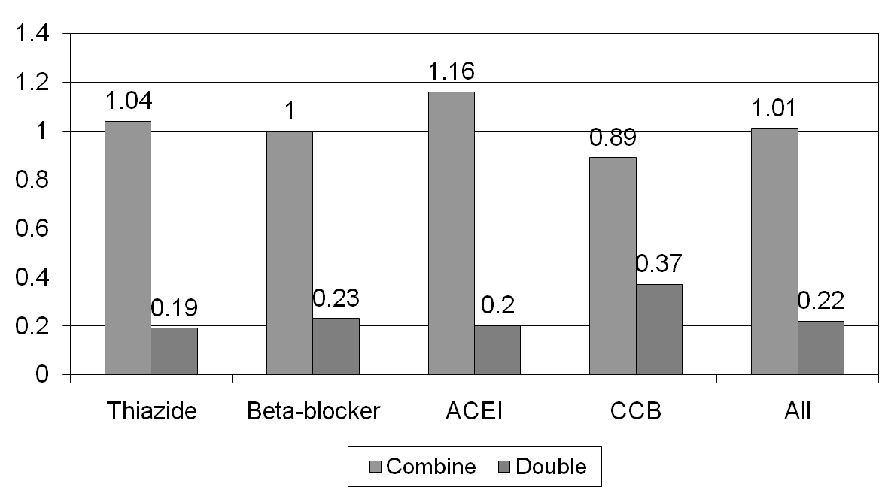
Incremental BP-Lowering Effect at Standard Doses: Combine or Double?
Incremental SBP reduction ratio observed/expected (additive)
Wald DS, et al. Am J Med 2009;122:290-300
Notes:
44
44
This meta-analysis of 42 trials (involving 10,968 participants) had a 2 x 2 factorial design comparing placebo, two individual drugs, and the combination. The drugs were drawn from the classes of thiazides, beta-blockers, ACEIs, and CCBs.
Combining any of these two classes of drugs produced approximately additive effects on BP reduction, and doubling the dose of a single drug had only one-fifth the incremental effect of combining with a different drug.
An earlier meta-analysis by the same research group showed that most of the BP reductions obtained with monotherapy were achieved at half the standard doses with considerably less adverse event (AE) burden; moreover, the prevalence of adverse effects with drug combinations was less than additive.
References:
Wald DS, et al. Combination therapy versus monotherapy in reducing blood pressure: meta-analysis on 11,000 participants from 42 trials. Am J Med. 2009; 122: 290-300.
Law MR, et al. Value of low dose combination treatment with blood pressure lowering drugs: analysis of 354 randomised trials. BMJ. 2003; 326: 1427-1431.
44

Slide 45
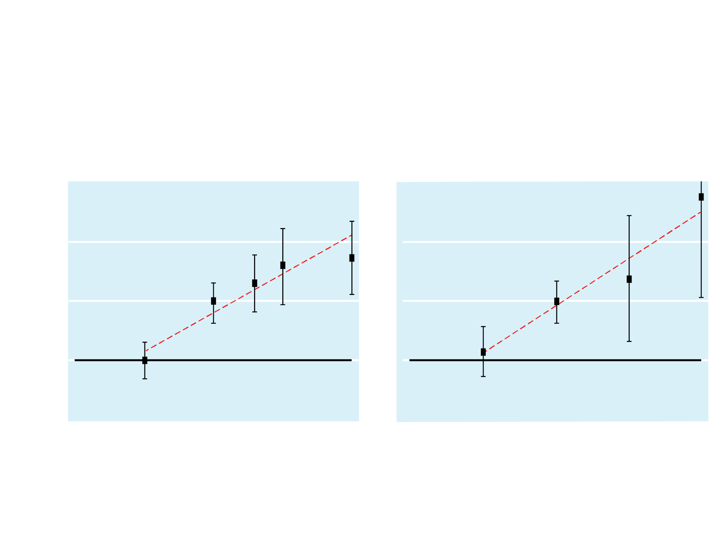
At Low Doses the Adverse Effects of Most Antihypertensives Approach those of Placebo
Calcium Channel Blockers
Thiazides
30
30
20
20
Side effect prevalence (%-placebo rate)
10
10
0
0
-10
-10
1/4
1/2
1
2
4
1/4
1/2
1
2
4
Dose as a proportion of the standard dose
Law, M R et al. BMJ 2003;326:1427
Notes:
In this meta-analysis of 354 RCTs involving 40,000 actively treated patients and 16,000 placebo patients, all classes of antihypertensive medications (i.e. thiazides, beta-blockers, ACEIs, ARBs and CCBs) produced similar reductions in BP (mean 9.1/5.5 mmHg at standard doses and 7.1/4.4 mmHg at half-standard dose). In other words, dropping the dose of antihypertensive by half reduced their antihypertensive potency by ~20%.
Combining antihypertensive medications showed additive antihypertensive potency, but did not result in additive side effects, supporting the use of low-dose combinations of different classes of antihypertensive medications for added efficacy with more favourable tolerability.
Reference
Law MR, et al. Value of low dose combination treatment with blood pressure lowering drugs: analysis of 354 randomised trials. BMJ. 2003; 326: 1427.

Slide 46
Initial SPC Therapy Improves
BP Control Rates: STITCH Study
Cluster randomized controlled trial - hypertension in family practices
Simplified algorithm featuring initial therapy with low-dose antihypertensive single drug combination vs. conventional guideline-based care
Low-dose - by splitting usual starting dose in half
Practitioners randomly assigned to use STITCH care or usual stepwise management according to CHEP guidelines
Feldman RD, et al. Hypertension 2009;53(4):646-53
Notes:
STITCH (Simplified Approach to the Treatment of Uncomplicated Hypertension) was a cluster randomized controlled trial in which a simplified algorithm involving a low-dose antihypertensive drug combination was compared with conventional guideline-based care for the treatment of hypertension in the family practice setting.
The low dose was achieved by splitting the usual starting dose in half. Practitioners were randomly assigned in a 1:1 ratio to use the STITCH care treatment algorithm for hypertension management, or to continue with usual stepwise management according to Hypertension Canada (CHEP) guidelines.
Reference
Feldman RD, Zou GY, Vandervoort MK, et al. A simplified approach to the treatment of uncomplicated hypertension: a cluster randomized, controlled trial. Hypertension. 2009; 53(4): 646-653.

Slide 47
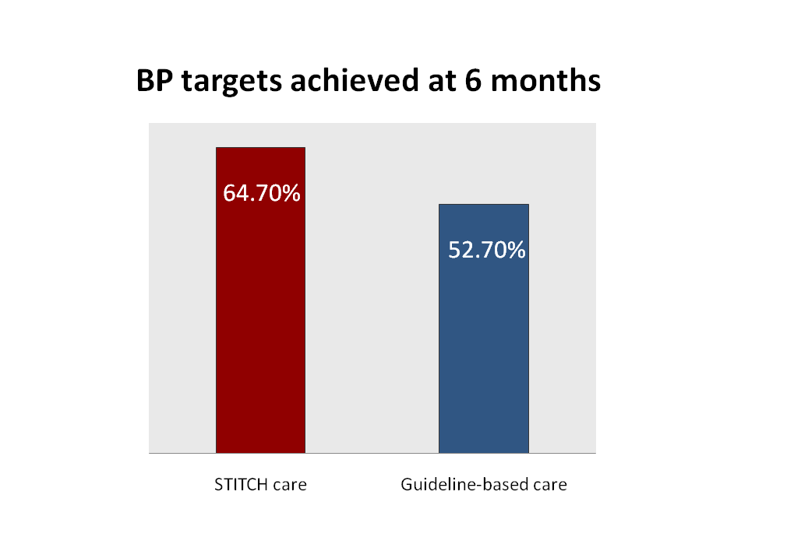
STITCH Study: Results
Absolute difference: 12.0%
95% CI 1.5-22.4%
P = 0.026
Relative difference: 23%
Feldman RD, et al. Hypertension 2009;53(4):646-53
Notes:
The analyses were based on data collected from 2104 patients with uncontrolled hypertension at baseline. At 6 months, the proportion of patients achieving BP targets was significantly higher with STITCH care compared with guideline-based care (64.7% vs. 52.7%; absolute difference: 12.0%; 95% CI, 1.5- 22.4%; P = 0.026). STITCH care increased the chance of reaching the target by 20% (P = 0.028).
Patients treated according to STITCH care did not receive more aggressive treatment, and hence is it not known if the STITCH algorithm reduced clinical inertia. The authors speculate that the effectiveness of STITCH may be related to better adherence by patients and/or the use of more effective drug combinations.
Unlike several previous studies that have suggested initial therapy with specific fixed-dose combinations and relatively high initial drug doses, the STITCH study used a simplified treatment algorithm that did not require the use of specific drug combinations. Therefore, the findings of this study can be considered to be more widely generalizable for the management of hypertension.
Reference
Feldman RD, Zou GY, Vandervoort MK, et al. A simplified approach to the treatment of uncomplicated hypertension: a cluster randomized, controlled trial. Hypertension. 2009; 53(4): 646-653.

Slide 48
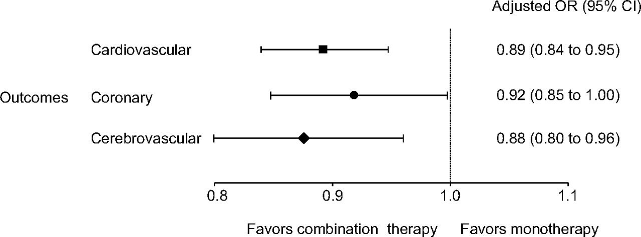
Initial Combination Therapy Reduces CV Risk
(observational study)
Corrao G, et al. Hypertension 2011;58(4):566-72
Notes:
A study involving a large cohort of high cardiovascular risk patients (n=209 650) newly treated with antihypertensive drugs and followed for several years found that initial combination therapy was associated with an 11% (95% CI, 5-16%; p-value not provided) reduction in CV risk compared to initial monotherapy.
Furthermore, patients who started on combination therapy and maintained it for the entire observation period had 26% (95% CI: 15% to 35%; p-value not provided) reduction of CV risk compared with patients who received monotherapy during follow-up.
The study demonstrated that initial combination treatment is associated with a greater CV protective effect (including prevention of both cerebrovascular and coronary events) compared to initial monotherapy and later moving to combination therapy.
This figure shows a Forest plot comparing odds ratios (and corresponding 95% CIs) of nonfatal CV outcomes as a whole, coronary heart disease, or cerebrovascular events associated with an initial combination of blood pressure-lowering agents, with respect to initial monotherapy. Data show the estimates obtained by fitting a conditional logistic model and adjusted for the number of blood pressure-lowering drug classes used during follow-up and the concomitant use of drugs for the treatment of heart failure, coronary heart disease, diabetes mellitus, and other CV disease.
Reference
Corrao G, Nicotra F, Parodi A, et al. Cardiovascular Protection by Initial and Subsequent Combination of Antihypertensive Drugs in Daily Life Practice. Hypertension. 2011; 58(4): 566-572.

Slide 49
Initial Combination Therapy
Reduces CV Risk (observational study)
 | Incidence Rate* (Combination Therapy vs. Add-on) | IRR (95% IC)↑ | P-Value†
All Patients (1762 Patients in Each Cohort)
Acute Myocardial Infarction Stroke/TIA Hospitalization for Heart Failure Overall Overall (With Death) | 0.45 vs. 0.99 2.57 vs. 2.84 0.56 vs. 0.78 3.34 vs. 4.10 3.58 vs. 4.28 | 0.19 (0.10 – 0.34) 0.79 (0.59 – 1.06) 0.54 (0.31 – 0.95) 0.62 (0.48 – 0.80) 0.66 (0.52 – 0.84) | <.0001 0.1172 0.0311 0.0002 0.0006
Excluding Patients with Diabetes or CKD (803 Patients in Each Cohort)
Acute Myocardial Infarction Stroke/TIA Hospitalization for Heart Failure Overall Overall (With Death) | 0.24 vs. 0.68 1.82 vs. 2.58 0.34 vs. 0.63 2.39 vs. 3.55 2.49 vs. 3.68 | 0.12 (0.04 – 0.37) 0.55 (0.33 – 0.91) 0.41 (0.15 – 1.14) 0.44 (0.28 – 0.68) 0.45 (0.29 – 0.69) | 0.0002 0.0200 0.0875 0.0002 0.0002
0
0.25
0.5
0.75
1.00
1.25
Combination Therapy Better
Add-on Better
Gradman AH, et al. Hypertension 2013;61(2):309-18
Notes:
A retrospective study (n=1762) of combination therapy versus monotherapy with later switching to combination therapy found that initial combination therapy was associated with a significant reduction in the risk of CV events or death (incidence rate ratio, 0.66 [95% CI, 0.52-0.84]; P = 0.0008).
After 6 months of therapy, 40.3% and 32.6% of patients with initial versus delayed combination treatment reached BP control, respectively.
Achieving target BP was associated with a statistically significant risk reduction of 23% for CV events or death (HR, 0.77 [95% CI, 0.61-0.96]; P = 0.0223). More rapid achievement of target BP was the main contributor to the risk reduction, regardless of diabetes mellitus or chronic kidney disease status at baseline. However, the residual effect of initial combination therapy did not reach statistical significance (HR, 0.84 [95% CI, 0.68-1.03]; P=0.0935). (Note: P-value is significant at 6 months, but not at 48 months).
This figure shows Kaplan-Meier estimates of achieving target BP for all patients with and without a CV event during follow-up.
Reference
Gradman AH, Parisé H, Lefebvre P, et al. Initial Combination Therapy Reduces the Risk of Cardiovascular Events in Hypertensive Patients: A Matched Cohort Study. Hypertension. 2013; 61(2): 309-318.

Slide 50
SPC Combining an ACEI/ARB
With CCB/Diuretic as First Line Rx
2 key studies establishing the utility of SPCs as first line:
HOPE-3. N Engl J Med 2016;374(21):2009-20
  Pivotal study demonstrating the superiority of an SPC
  (ARB/diuretic) vs. Placebo
  ACCOMPLISH. N Engl J Med 2008;359(23):2417-28
  Demonstration of efficacy of ACEI/CCB SPC vs. active control
Notes:
According to the Hypertension Canada 2017 guidelines, the most compelling evidence for single pill combination as initial therapy comes from the ACCOMPLISH (Avoiding Cardiovascular Events through Combination Therapy in Patients Living with Systolic Hypertension) trial and the more recent HOPE-3 (Heart Outcomes Prevention Evaluation) trial.
The HOPE-3 trial showed that the combination of rosuvastatin (10 mg per day), candesartan (16 mg per day), and hydrochlorothiazide (12.5 mg per day) was associated with a significantly lower rate of CV events than dual placebo among persons at intermediate risk who did not have CVD.
The ACCOMPLISH trial showed that a combination of benazepril-amlodipine was superior to benazepril-HCTZ in reducing major adverse cardiac events (9.6% vs. 11.8%, HR 0.80, 95% CI 0.72 to 0.90; P<0.001).
References
Leung AA, et al. Hypertension Canada’s 2017 Guidelines. Can J Cardiol. 2017.
Lonn EM, et al. Blood-pressure lowering in intermediate-risk persons without cardiovascular disease. N Engl J Med. 2016; 374: 2009-2020.
Jamerson K, et al. Benazepril plus amiloride or hydrochlorothiazide for hypertension in high-risk patients. N Engl J Med. 2008; 359: 2417-2428.

Slide 51
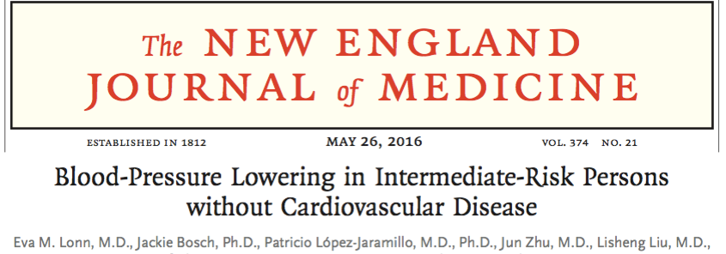
HOPE-3
Design: 2x2 factorial RCT (double-blind)
Population: intermediate-risk (no CVD); 22% had BP Rx at baseline; n=12,705
Intervention: candesartan 16 mg/d plus HCTZ 12.5 mg/d
vs. candesartan 16 mg/d plus placebo
1° outcomes: overall, no significant differences in first (p=0.40)
or the second co-primary outcomes (p=0.51)
  coprimary #1: CV death, nonfatal MI, or nonfatal stroke
  coprimary #2: #1 plus resuscitated cardiac arrest, HF, revascularization
Notes:
The HOPE-3 trial included men 55 years of age or older and women 65 years of age or older who had at least one CV risk factor. The median follow-up was 5.6 years.
The main trial evaluated a fixed-dose combination of an ARB and a thiazide diuretic, cholesterol-lowering therapy with a statin, and the combination of both interventions in persons at intermediate cardiovascular risk.
The overall results show that the combination of rosuvastatin (10 mg per day), candesartan (16 mg per day), and hydrochlorothiazide (12.5 mg per day) was associated with a significantly lower rate of CV events than dual placebo among persons at intermediate risk who did not have CVD.
Reference
Lonn EM, et al. Blood-pressure lowering in intermediate-risk persons without cardiovascular disease. N Engl J Med. 2016; 374: 2009-2020.

Slide 52
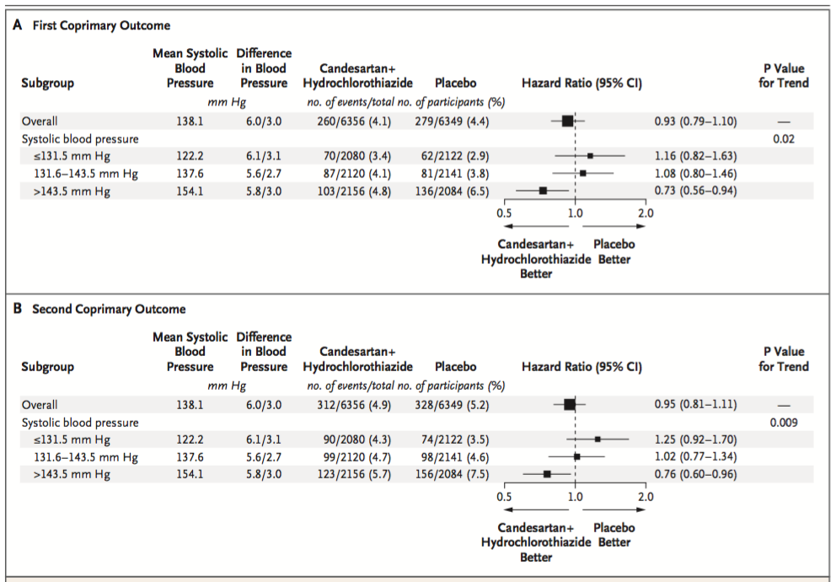
HOPE-3
Outcome - as Tertiles of Initial BP
HOPE-3. N Engl J Med 2016;374(21):2009-20
Notes:
In a pre-specified subgroup analysis, subjects in the upper third of SBP (>143.5 mmHg; mean, 154.1±8.9 mmHg) with combination treatment had lower events for the first (HR, 0.73; 95% CI, 0.56 to 0.94), and second coprimary outcomes (HR, 0.76; 95% CI, 0.60 to 0.96). Effects were neutral in the middle and lower thirds.
There was no significant difference in the rate of serious AEs.
Reference
Lonn EM, et al. Blood-pressure lowering in intermediate-risk persons without cardiovascular disease. N Engl J Med. 2016; 374: 2009-2020.

Slide 53
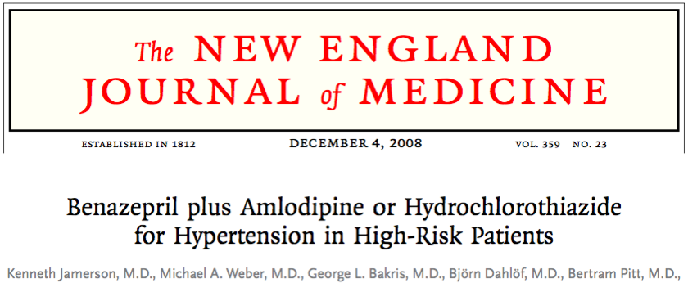
ACCOMPLISH
Design: RCT (double-blind)
Population: high-risk; 97% had BP Rx at baseline; n=11,506
Intervention: benazepril plus amlodipine vs. benazepril plus HCTZ
1° outcomes: CV death, nonfatal MI, nonfatal stroke, hosp. for angina, resuscitation after cardiac arrest, and coronary revasc.
  Terminated early after mean follow-up of 36 m
Notes:
The ACCOMPLISH trial included high-risk patients with hypertension and a history of CV events, MI, revascularization, or stroke +/- chronic kidney disease, peripheral arterial disease, left ventricular hypertrophy, or diabetes mellitus.
The study was terminated early after mean follow-up of 36 months because the pre-specified stopping rule was exceeded.
Reference
Jamerson K, et al. Benazepril plus amlodipine or hydrochlorothiazide for hypertension in high-risk patients. N Engl J Med. 2008; 359: 2417-2428.

Slide 54
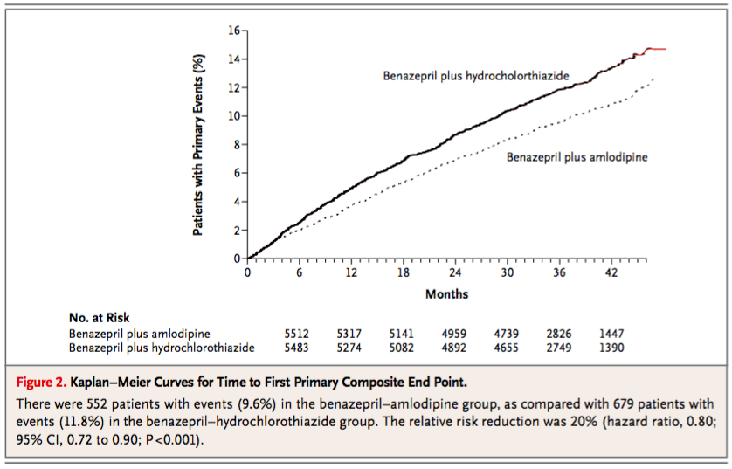
ACCOMPLISH
ARR = 2.2%
(11.8% vs. 9.6% for
ACEI-HCTZ vs.
ACEI-CCB)
RRR = 19.6%
(HR, 0.80; p<0.001)
Benazepril–amlodipine superior to benazepril-HCTZ in reducing MACE
ACCOMPLISH. N Engl J Med 2008;359(23):2417-28
Notes:
The primary outcome was a composite of death from CV causes, nonfatal MI, nonfatal stroke, hospitalization for angina, resuscitation after sudden cardiac arrest, and coronary revascularization.
A primary outcome event occurred in 9.6% of subjects in the ACEI-CCB group, and 11.8% in the ACEI-HCTZ group. Absolute risk reduction with benazepril–amlodipine therapy was 2.2% and the relative risk reduction was 19.6% (HR, 0.80, 95% CI, 0.72 to 0.90; P<0.001).
The rates of drug discontinuations due to adverse events were similar in the two groups.
Reference
Jamerson K, et al. Benazepril plus amiloride or hydrochlorothiazide for hypertension in high-risk patients. N Engl J Med. 2008; 359: 2417-2428.

Slide 55
First Line Treatment of Adults With Systolic/Diastolic Hypertension Without Other Compelling Indications
TARGET <135/85 mmHg (automated measurement method)
New 2017
INITIAL TREATMENT
Health behaviour management
Thiazide/
thiazide-like*
ACEI§
ARB
Long-acting
CCB
Beta-
blocker†
Single pill
combination**
* Longer-acting (thiazide-like) diuretics are preferred over shorter-acting (thiazide) diuretics
† BBs are not indicated as first line therapy for age 60 and above
**Recommended SPC choices are those in which an ACE-I is combined with a CCB,
an ARB with a CCB, or an ACE-I or ARB with a diuretic
§Renin angiotensin system (RAS) inhibitors are contraindicated in pregnancy and
caution is required in prescribing to women of child bearing potential
Notes:
This represents the latest Hypertension Canada 2017 treatment algorithm for 1st-line treatment of adults with hypertension without other compelling indications.
Reference
Leung AA, et al. Hypertension Canada’s 2017 Guidelines. Can J Cardiol. 2017.

Slide 56
Hypertension 2017
What’s new?
Longer-acting (thiazide-like) diuretics are preferred
vs. shorter-acting (thiazides)
Single pill combinations as a first line treatment (regardless of the extent of BP elevation)
Notes:
This educational program has reviewed two of the 10 new recommendations in the Hypertension Canada 2017 guidelines. Both these recommendations address guidelines for first-line pharmacotherapy, namely strategies that offer greater effectiveness and convenience for patients.

Slide 57
Hypertension 2017
What’s still important?
The diagnosis of hypertension should be based
on out-of-office measurements; in the office,
use automated office BP measurement (AOBP)
The threshold and target blood pressures are lower
in those at greater risk
Notes:
This educational program has also reviewed two recommendations previously made by the Hypertension Canada 2016 guidelines. These two recommendations address guidelines for the assessment of hypertension and BP targets, and represent important changes that still remain very important for the optimal management of patients with hypertension.

Slide 58
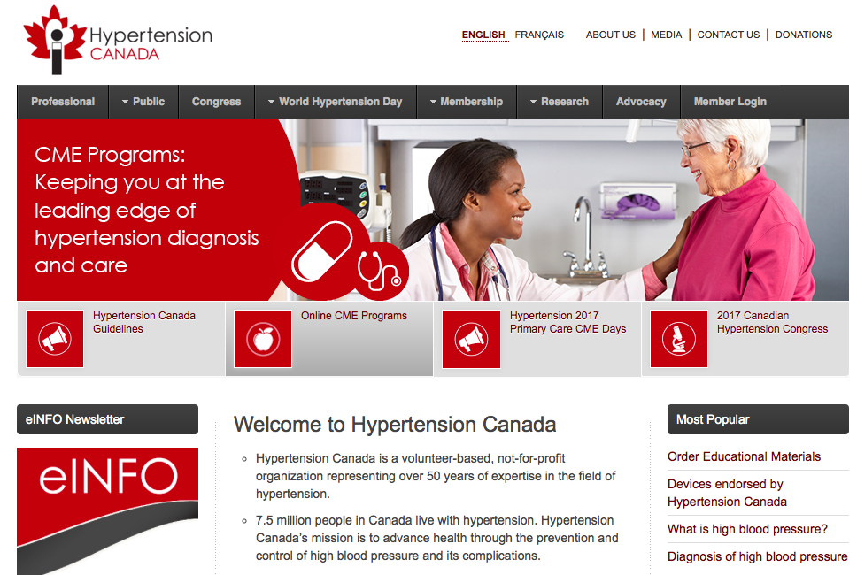
hypertension.ca
For patients:
Free access to the latest information and resources
For professionals:
Accredited 15.5 hour interdisciplinary training program
Free monthly news updates, featured research and educational resources
Become a member for special privileges and savings
Notes:
Ask your patients to visit the public section of the website for free access to the latest information and resources.
Special efforts are being made for health care professionals to have greater accessibility to hypertension resources. Health care professionals can enroll at www.hypertension.ca to get automated email notices when new or updated hypertension resources are available for you and for your patients.
A case-based interactive lecture series on clinically important hypertension topics is available on the internet to provide additional learning opportunities, and for you to interact with national hypertension experts. The lecture series will feature important clinical topics provided by national experts, with case presentations and an opportunity to ask questions and make comments.
We will also continue and expand our programs to train community leaders in hypertension.

